Slide 1

The History of the
Soil and Water Conservation Districts
The Dust Bowl to Today
Updated 11/2018
Notes:
The History of the Soil and Water Conservation Districts: The Dust Bowl to Today
Prepared by the Elkhart County Soil and Water Conservation District
All links and materials accurate as of January 2019

Slide 2

Learning Objectives
Do You Know?
What ecological disaster caused the creation of conservation districts?
Who was a key person or people in the formation of the Soil Conservation Service and the Soil and Water Conservation Districts?
What does our local Soil and Water Conservation District (SWCD) do?
Notes:
Learning Objectives: Discover the answers in the following slides.
Background: Indiana Soil and Water Conservation District
Across Indiana, 92 Soil and Water Conservation Districts (SWCDs) - one in every county - help Indiana residents to conserve land, water, forests, wildlife and related natural resources that encompass our state's 23 million acres. Their mission is to coordinate assistance from available sources - public and private, local, state and federal - in an effort to develop locally driven solutions to natural resource concerns.
Indiana's 92 SWCD supervisors represent over 450 volunteers across the state serving in elected or appointed positions on SWCD governing boards. These men and women, along with staff at the local level, work with landowners in the country, our cities and towns, and the land areas in between.
Local Soil and Water Conservation Districts are uniquely positioned to bring a critical environmental perspective to land use and economic development decisions. The future of conservation in Indiana is bright and the potential of local Districts is unlimited thanks to the commitment from elected officials and individuals, and due to continued support for Indiana conservation and our 92 Soil and Water Conservation Districts through Clean Water Indiana.
Soil and water / quality of life, they go hand-in-hand — clearly defining the health and sustainability of Indiana's rural and urban communities. Soil and water conservation also represents a strong and vibrant Indiana and ensures its future. Whether you live on a farm, in a small town, or in the heart of an urban center, health and sustainable Indiana communities begin with the wise management of our natural resources. And, the Indiana Association of Soil and Water Conservation Districts and local SWCDs are at the forefront of this conservation initiative.
https://www.in.gov/isda/2368.htm (Copy/paste into browser. Link checked correct on 12/3/2018)

Slide 3
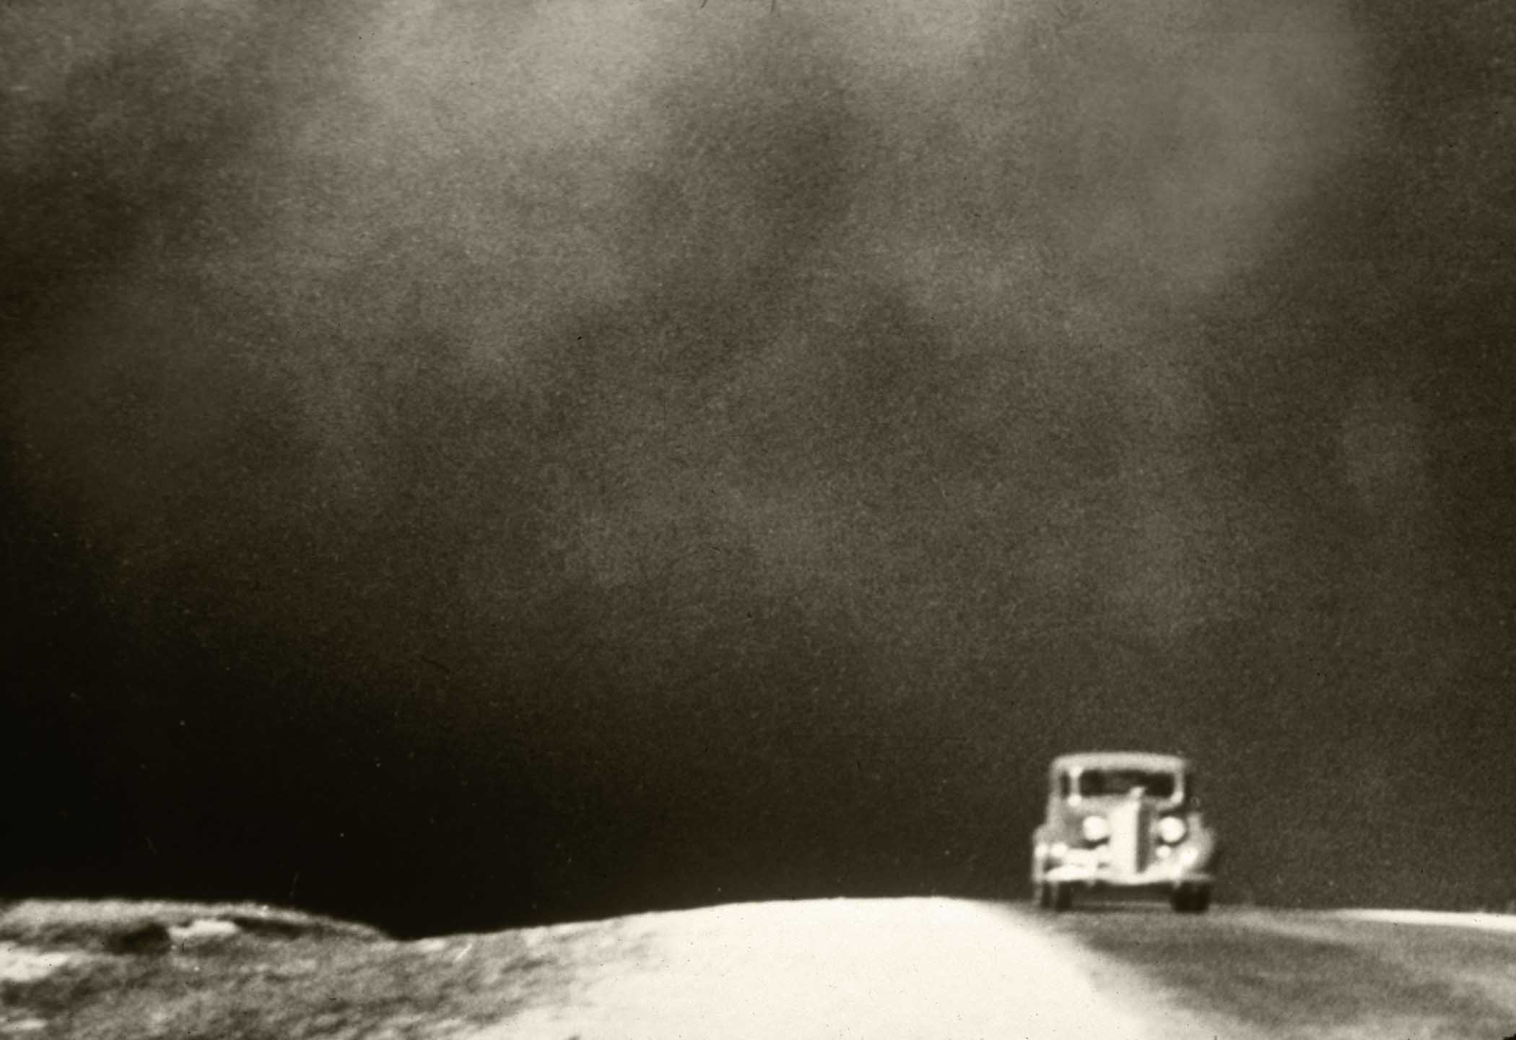
In the early 1930s, along with the Great Depression, came an ecological disaster known as the Dust Bowl.
Huge black dust storms stretched across the nation, blotted out the sun, and swallowed the countryside for nearly a decade.
Notes:
The Dust Bowl was a period of severe dust storms that greatly damaged the ecology and agriculture of the American and Canadian prairies during the 1930s; severe drought and a failure to apply dryland farming methods to prevent the aeolian processes (aka wind erosion) caused the phenomenon.
Educational Movie: http://www.pbs.org/kenburns/dustbowl/ (Copy/paste into browser. Link checked 12/3/2018.)

Slide 4
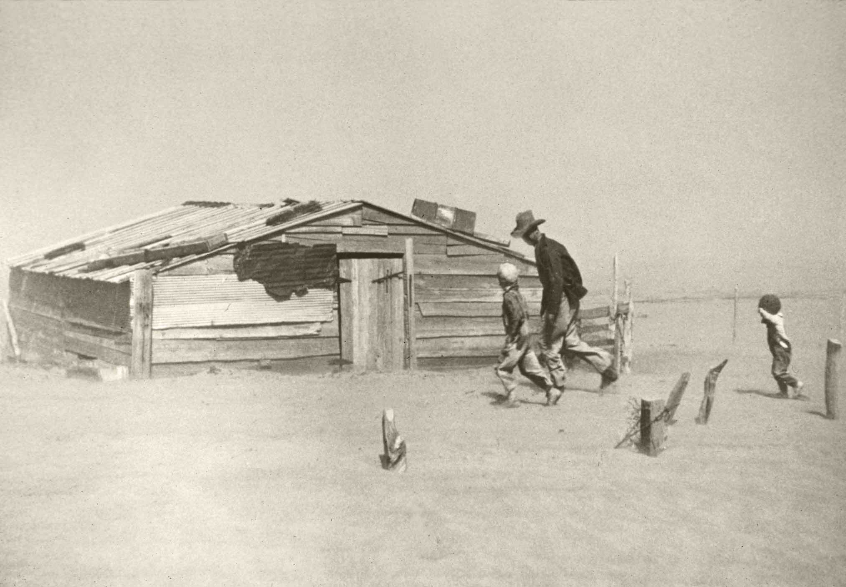
What Caused the
Dust Bowl?
Poor agricultural practices and years of sustained drought resulted in extensive soil erosion.
Notes:
Poor agricultural practices included: tillage, over-grazing, removal of windbreaks, not leaving residue or cover on the soil, and not rotating crops (planting the same thing year after year)
Those practice mixed with the drought spelled out disaster

Slide 5
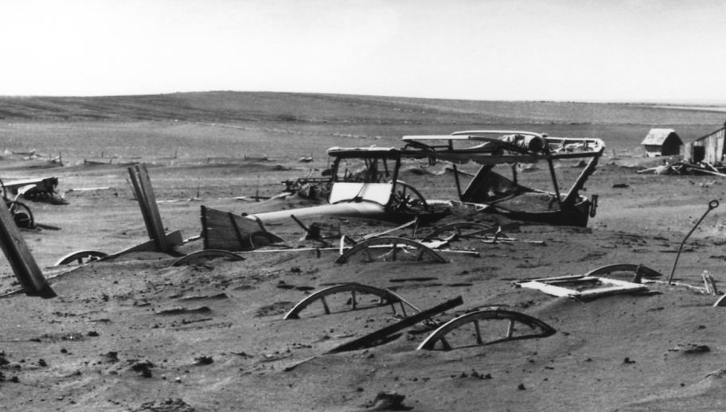
Conservation District Timeline
1931
Over-plowed and over-grazed land turns to dust when drought hits the Midwest and southern plains.
The drought is the worst in U.S. history, affecting more than 75% of the country.
100 million acres of cropland has lost topsoil.
May 1934
December 1934
Notes:
This timeline is meant to be an overview of events leading to the formation of conservation districts. Does not include all details.

Slide 6
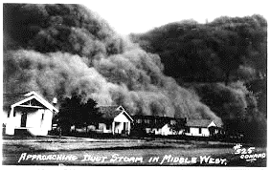
April 14, 1935
“Black Sunday” – the worst “black” blizzard of the Dust Bowl
Congress declares soil erosion a national menace and establishes the Soil Conservation Service within the US Department of Agriculture
.
April 27, 1935
Conservation District Timeline
Notes:
This timeline is meant to be an overview of events leading to the formation of conservation districts. Does not include all details.

Slide 7
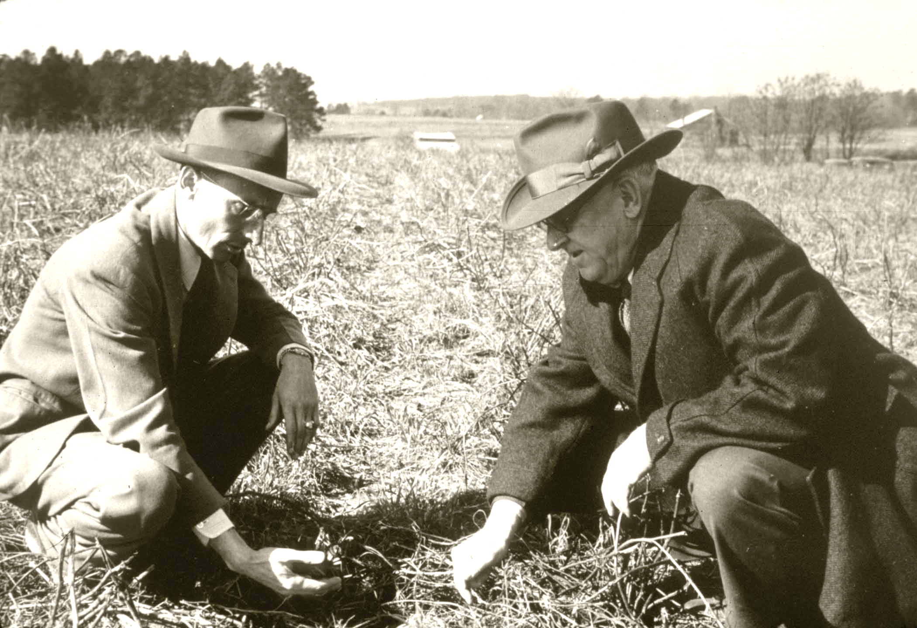
Many farmers did not trust the government at that time
but Congress realized that only active support from landowners would guarantee the success of conservation on private land
This is how the idea of Conservation Districts was born
Notes:
A brief pause in the timeline to explain what people were thinking (eg. “How are we going to fix this?”)

Slide 8
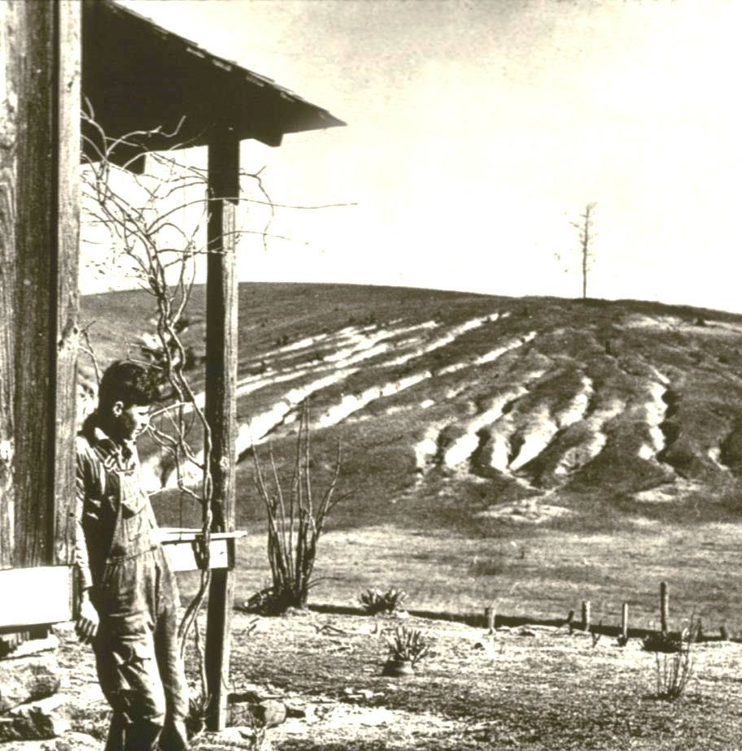
By December of 1935, an estimated 850 million tons of fertile topsoil had been blown off the southern Great Plains
It was time to implement the new legislation to start putting conservation practices on the land but there was a problem…
Notes:
There was a serious problem with soil erosion.
For scale: An elephant is an average of 5 tons. A car is about 2 tons.

Slide 9
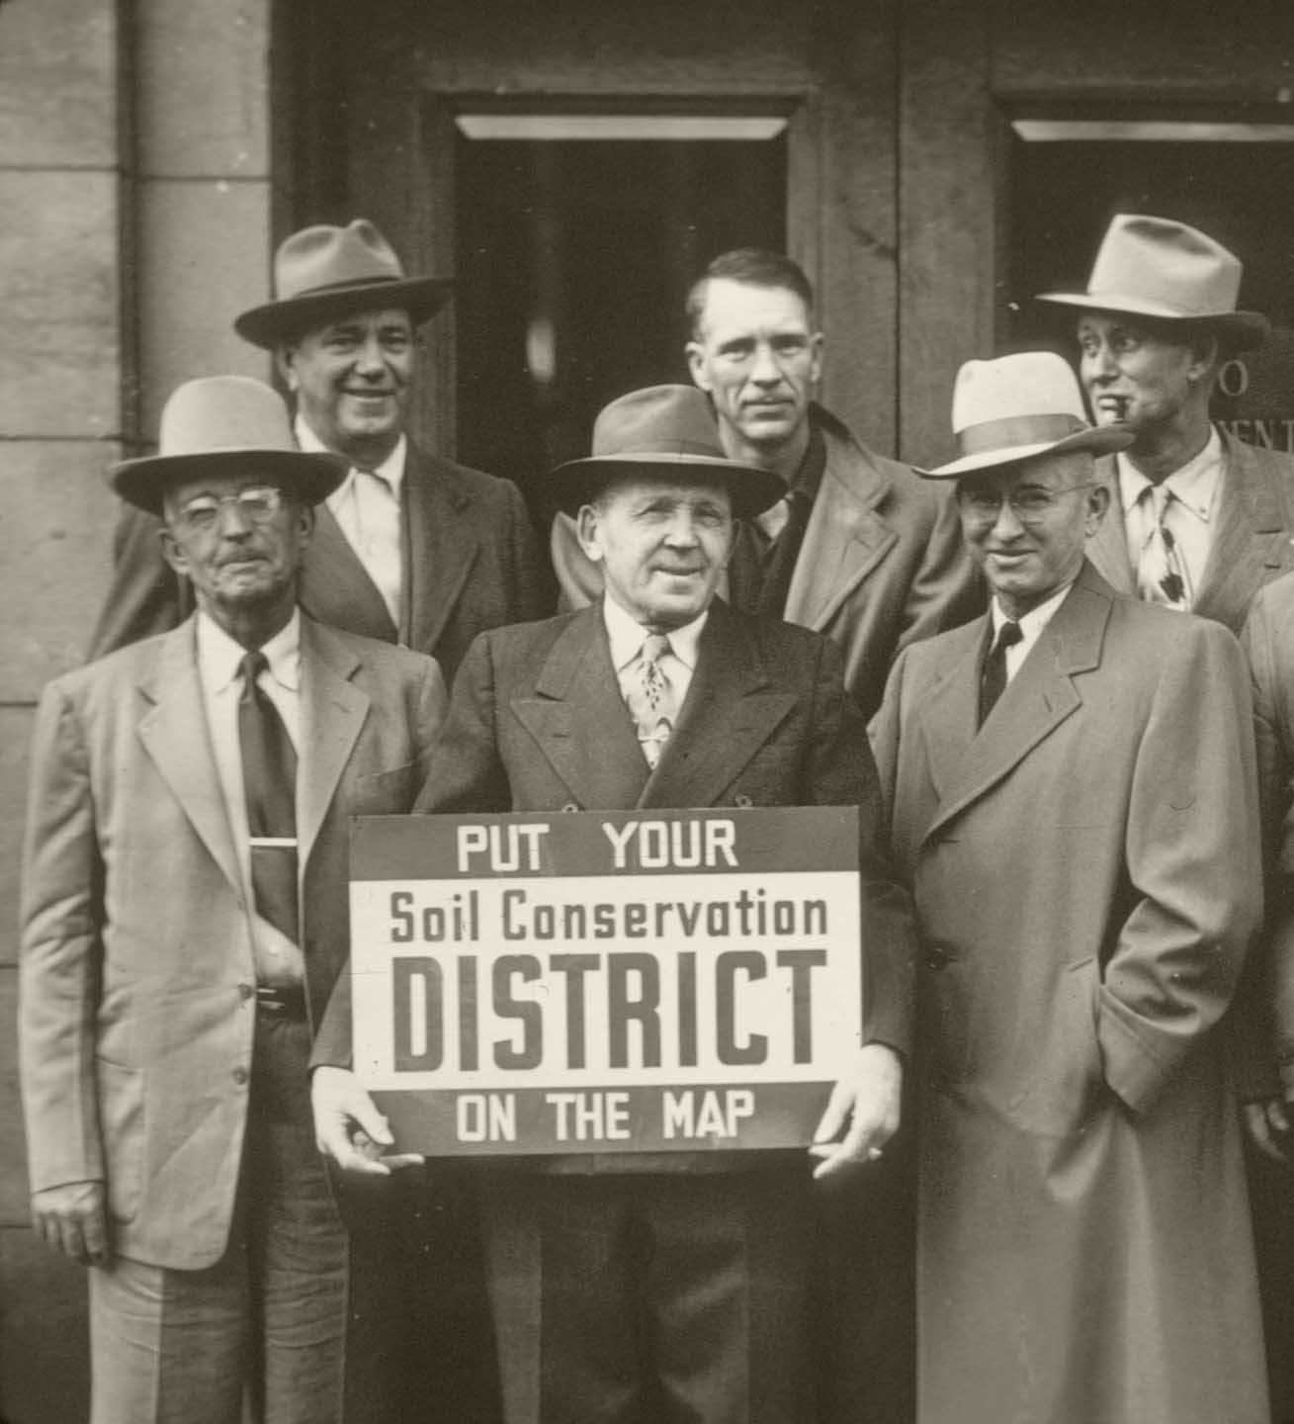
Conservation District Timeline
May 1936
SCS published the “Standard Conservation District Law”
Arkansas is the first state to enact the Standard Conservation District Law
The Brown Creek Soil Conservation District, in North Carolina, is the first Conservation District is organized
March 1937
August 1937
Notes:
This timeline is meant to be an overview of events leading to the formation of conservation districts. Does not include all details.

Slide 10
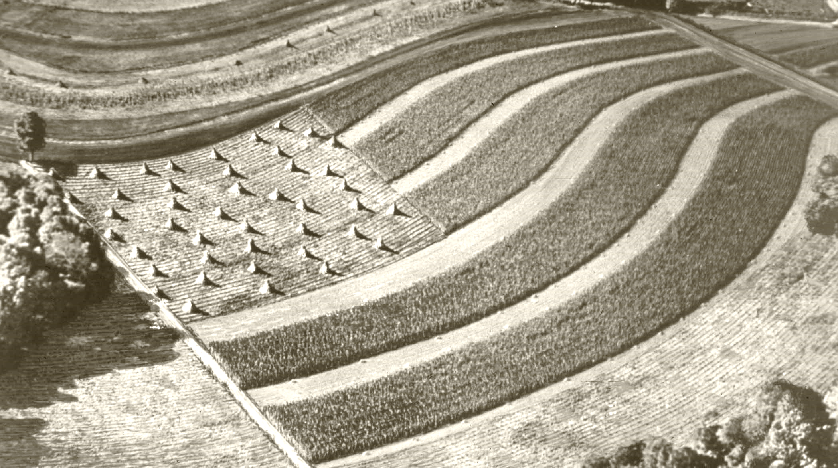
1938
Extensive conservation work has reduced blowing topsoil by 65%
Rain arrived, ending the Dust Bowl Drought
.
Fall 1939
Conservation District Timeline
Notes:
This timeline is meant to be an overview of events leading to the formation of conservation districts. Does not include all details.

Slide 11
In 1940, Indiana’s first Conservation District Law
(IC 13-3-1) was enacted.
Vanderburgh County was the first to establish a Soil and Water Conservation District in Indiana
Notes:
Vanderburgh SWCD, the first Soil and Water Conservation District in Indiana was established in 1940 shortly after Indiana’s first District Law (IC 13-3-1) was enacted.

Slide 12
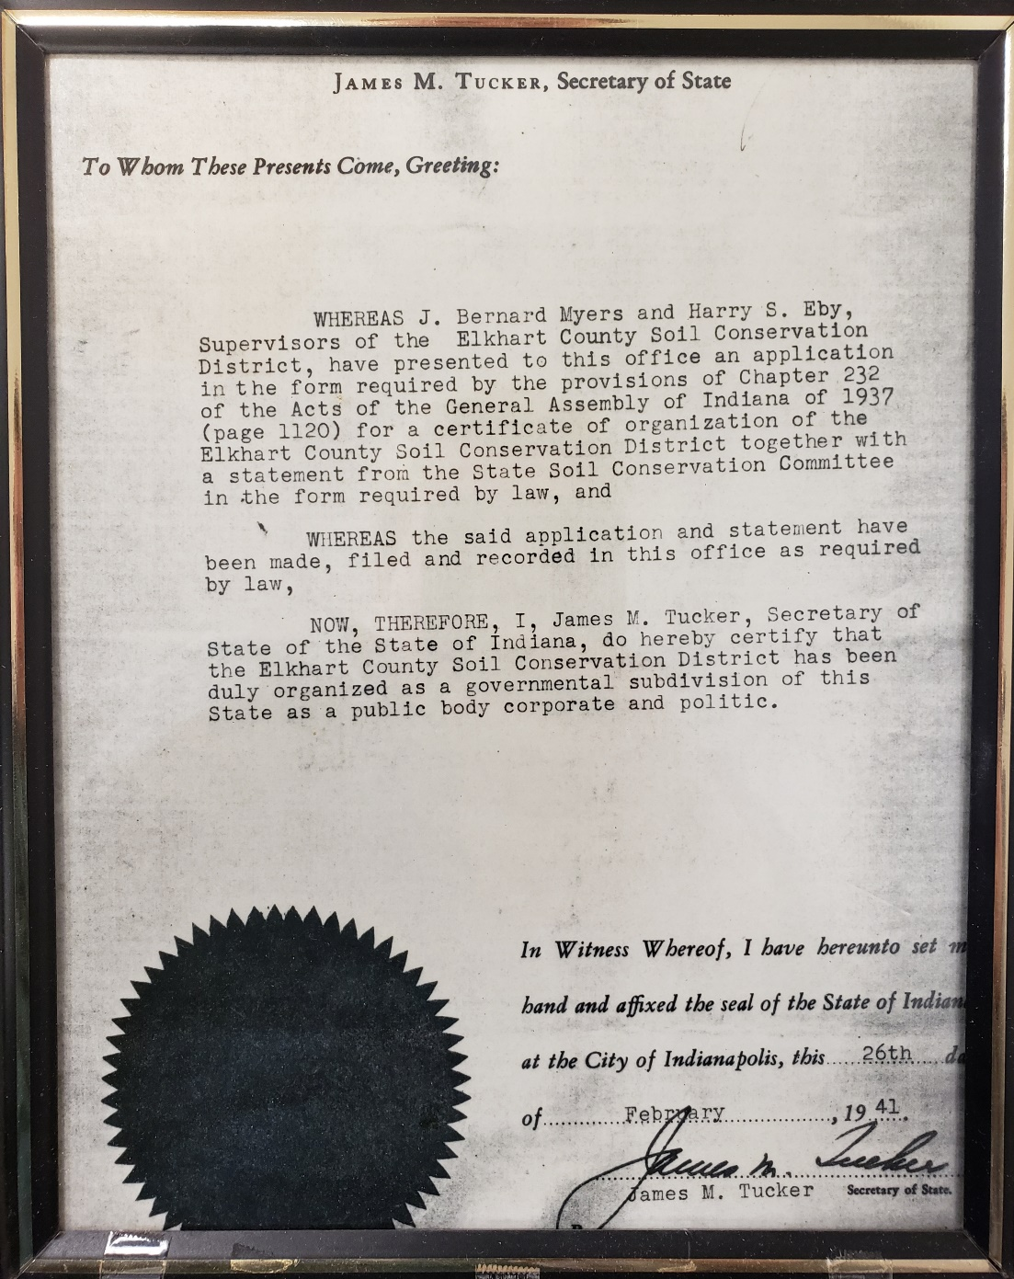
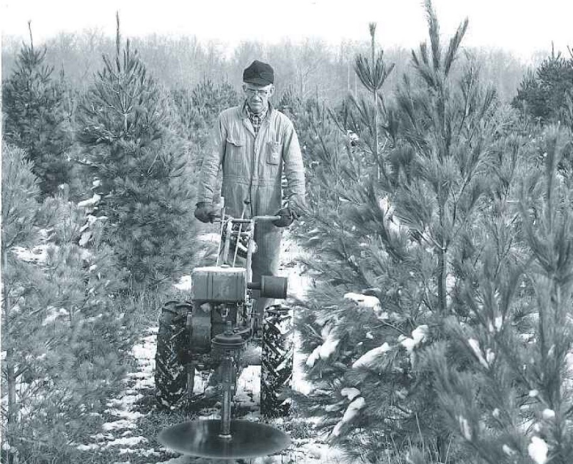
Elkhart County Soil and Water Conservation District was established on February 26, 1941
J. Bernard Myers and Harry S. Eby successfully applied to the State in order to establish the SWCD office
Harry Eby
Notes:
It was up to locals to start the SWCD in their area. Mr. Myers and Mr. Eby were the driving force behind the SWCD in Elkhart County

Slide 13
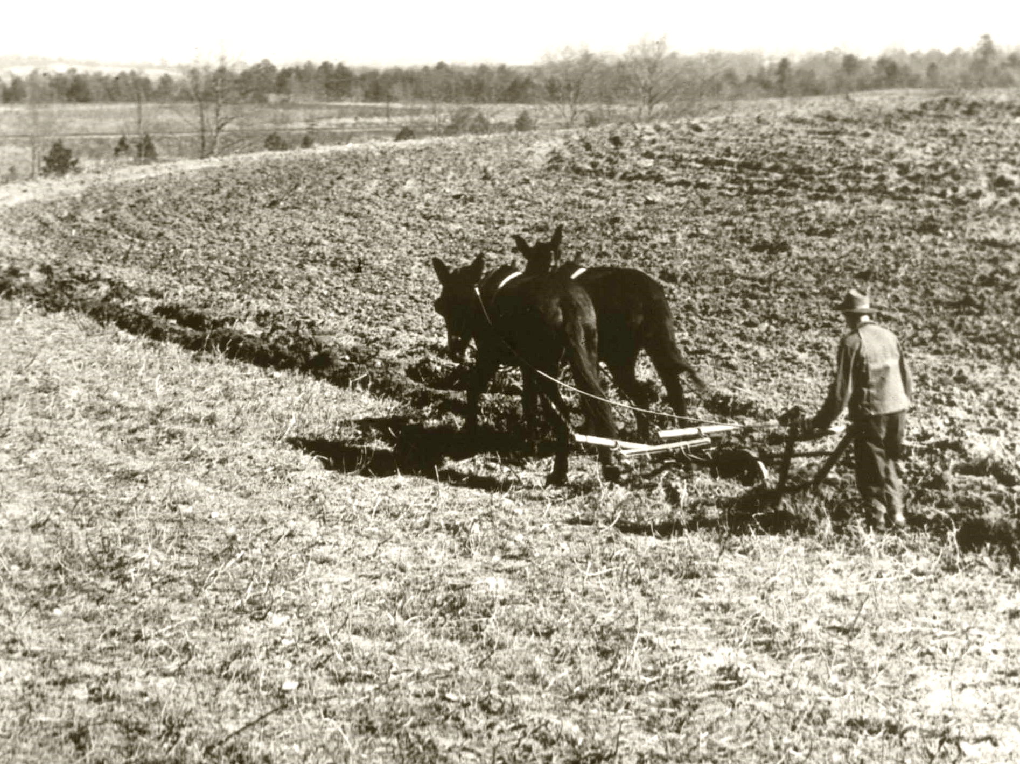
Early work by the Soil and Water Conservation Districts focused on assisting farmers with conservation “measures”
Now, we refer to these “measures” as practices. The goal was and is to keep soil from blowing and washing away (eroding)
Notes:
During the 1930s – 1960s a large majority of land that was privately owned belonged to farmers and ranchers. That meant that SWCD’s had to work with private landowners to make a difference.
Soil loss in the Southern Great Plains, where the Dust Bowl mainly occurred, is mostly due to wind erosion (aolian)
Soil loss in Elkhart County is mainly due to water erosion (runoff). Very generally speaking, we get too much rain in Elkhart County for an event like the Dust Bowl to happen here, since that was mainly wind erosion. That being said, if we don’t take care of our soil in Elkhart County, it may wash away through increased rainfall.

Slide 14
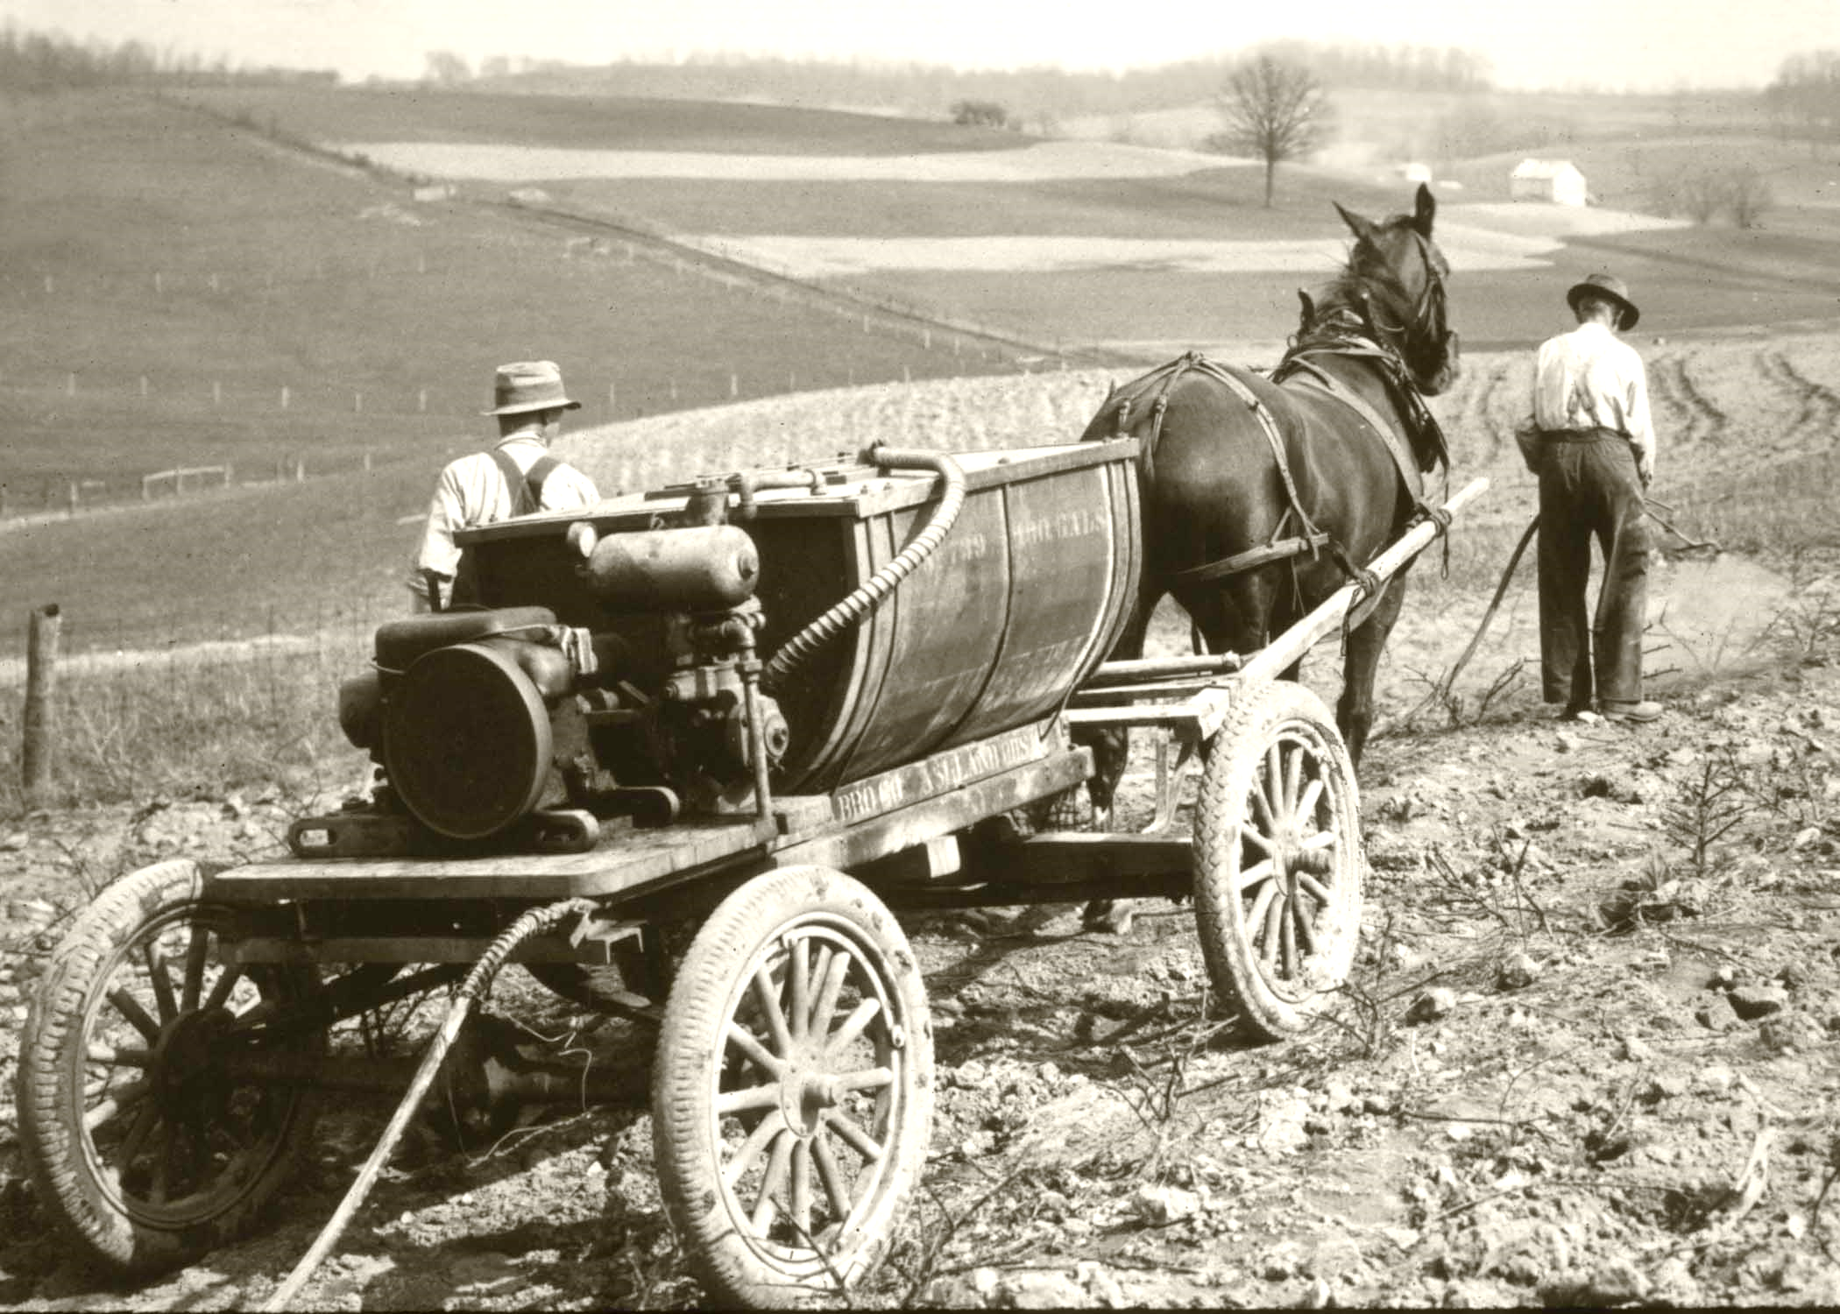
SWCD’s also helped put conservation on the ground by:
1. Making specialized equipment available for use by interested landowners
Notes:
Switching to conservation farming was and is not an easy process. It’s a different management style and often requires different equipment, which is (and was) expensive.
Imagine your whole life you have the same morning routine: shower, clothes, eat breakfast, brush teeth. Now a government agency comes in and tells you “No we want to save our environment, your routine is now: watch tv for an hour, shower, brush teeth, clothes, eat breakfast”. Do you have a tv? Is it worth changing? Are there incentives? What good does it do me to change my routine?
Conservation is not mandated, it’s totally voluntary. The SWCD’s were tasked with convincing landowners to change their routine/farm management for the betterment of land everywhere.

Slide 15
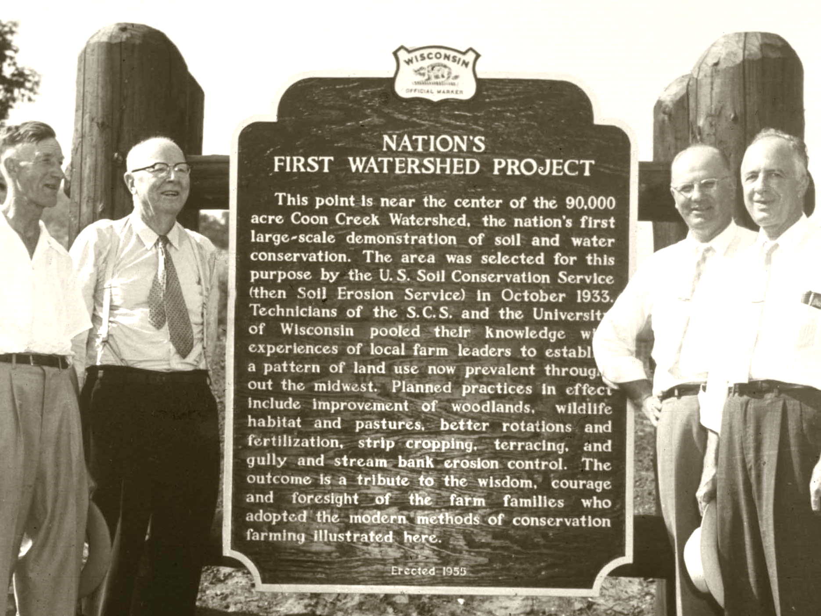
SWCD’s also helped put conservation on the ground by:
2. Being involved in watershed projects for flood control and drainage
Notes:
Land and water are intimately tied together in the health of our environment – that’s why we aren’t just the soil conservation district but the soil AND water conservation district

Slide 16
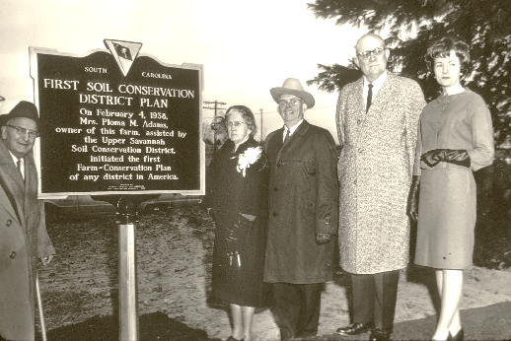
SWCD’s also helped put conservation on the ground by:
3. Helping landowners develop conservation plans, which outline best management practices for conservation on their property
Notes:
It helps many landowners switch to conservation practices if they have a plan to follow. This usually means switching to conservation practices slowly over the course of 3-5 years

Slide 17
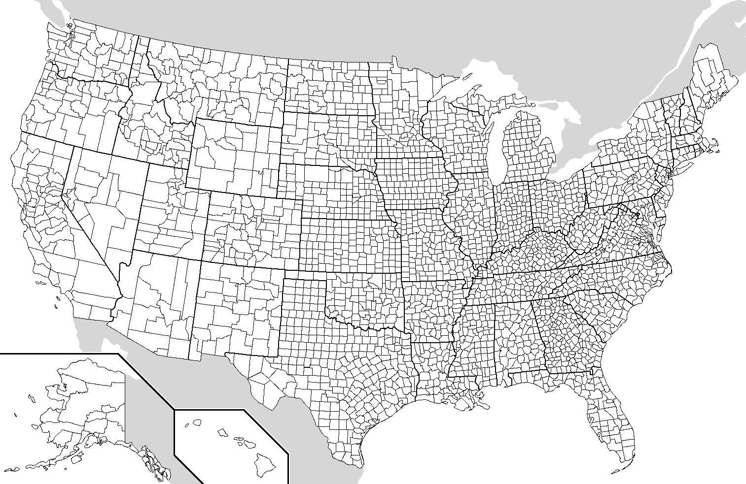
Today, there are nearly 3,000 SWCD’s nationwide
We’re here!
That’s 1 in almost every county in the U.S!
Notes:
Indiana has 92 counties and all of them have soil and water conservation districts.

Slide 18
Indiana Association of Soil and Water Conservation Districts
92 County Soil and Water Conservation Districts
Indiana Department of Environmental Management
Indiana Department of Natural Resources
ISDA Division of Soil Conservation
Purdue Cooperative Extension Service
State Soil Conservation Board
USDA Farm Service Agency
USDA Natural Resources Conservation Service
Indiana has a “Conservation Partnership” made up of many agencies
Our state has been nationally recognized for our collaborative efforts in getting conservation on the ground.
Notes:
Listed are the agencies in the Indiana Conservation Partnership
ISDA = Indiana State Department of Agriculture
USDA = United States Department of Agriculture

Slide 19
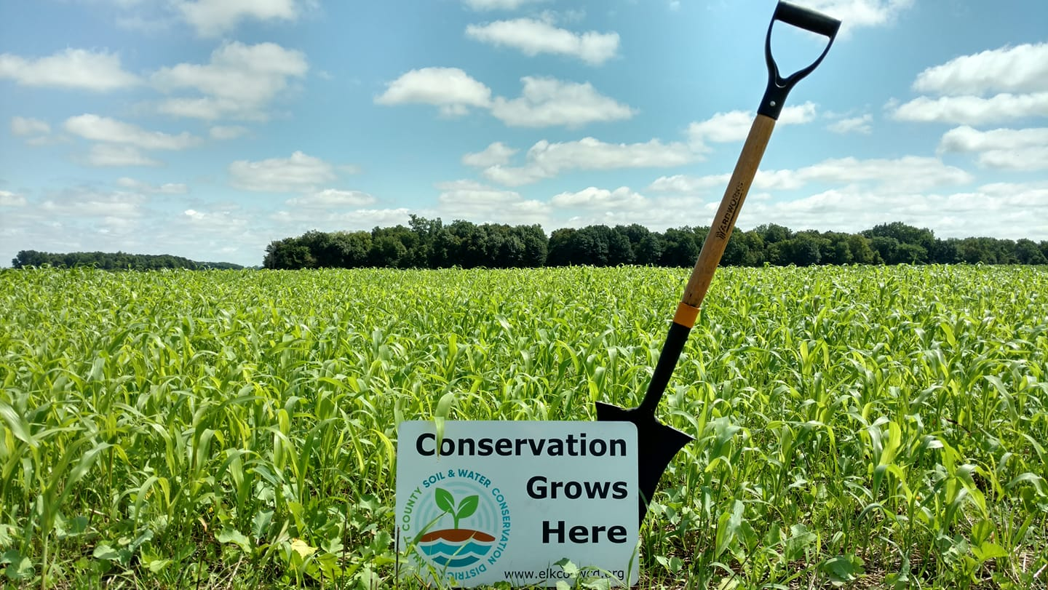
Within the Indiana Conservation Partnership, the Elkhart County SWCD has three main objectives
Notes:
The Elkhart County Soil and Water Conservation District is your local SWCD! (and the ones who made this presentation!)

Slide 20
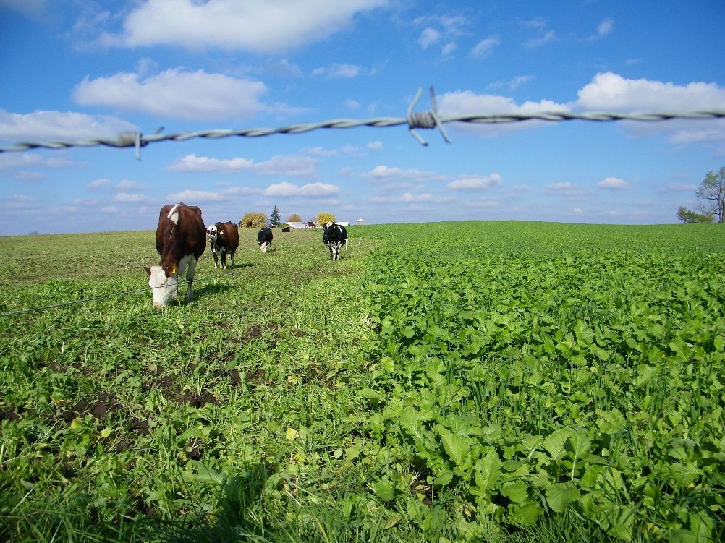
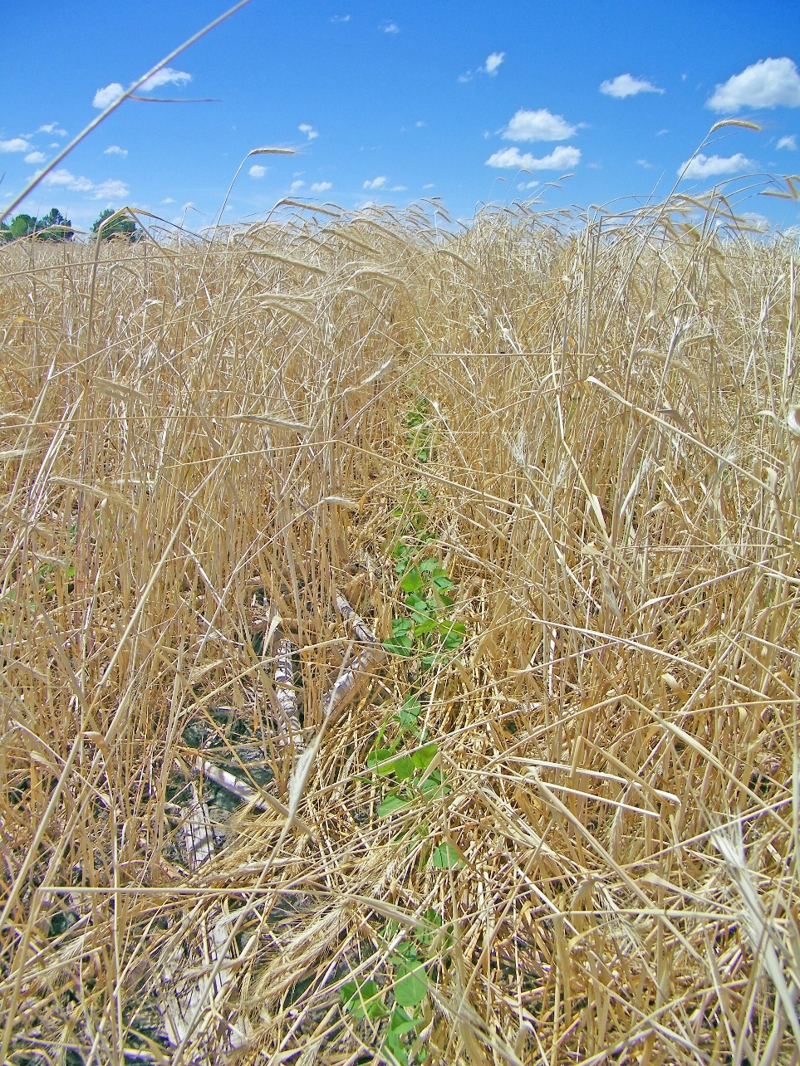
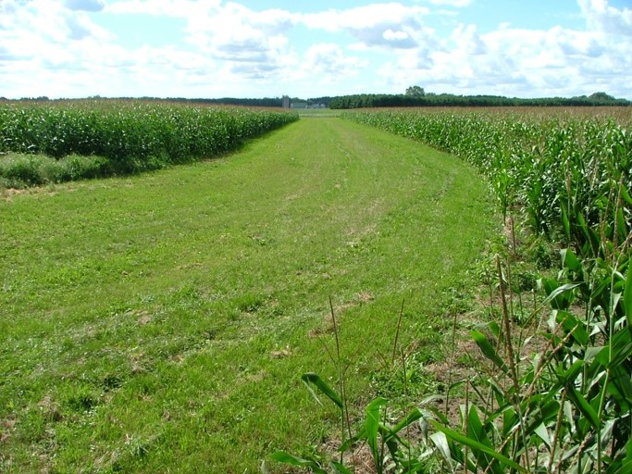
Agricultural Conservation
We are a resource for farmers to learn about and implement conservation practices, especially no-till, cover crops, and filter strips.
Notes:
Left picture (credit: Elkhart Co SWCD): soybeans no-till planted into a rye cover crop in Elkhart County, IN
Top Right (credit: Elkhart Co SWCD): Cattle grazing a cover crop mix in Elkhart County, IN
Bottom Right (credit: Elkhart Co SWCD): Grassed waterway through a corn field in Elkhart County, IN

Slide 21
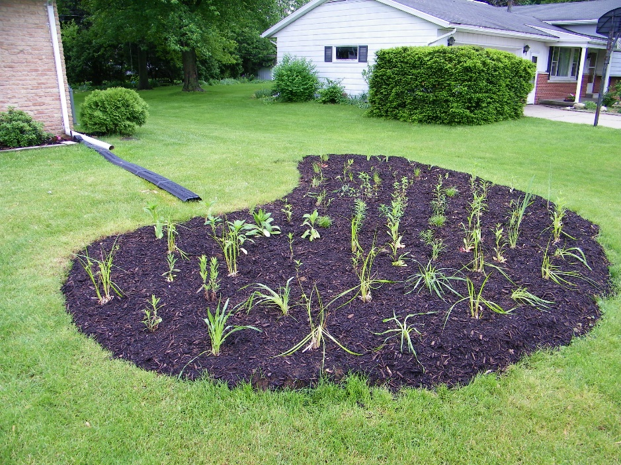
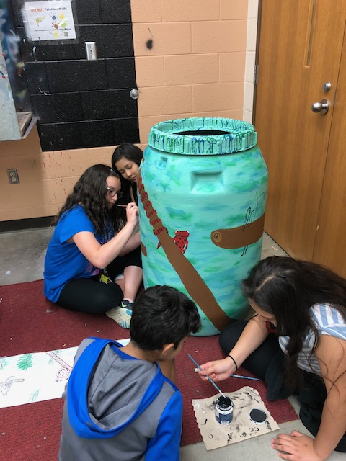
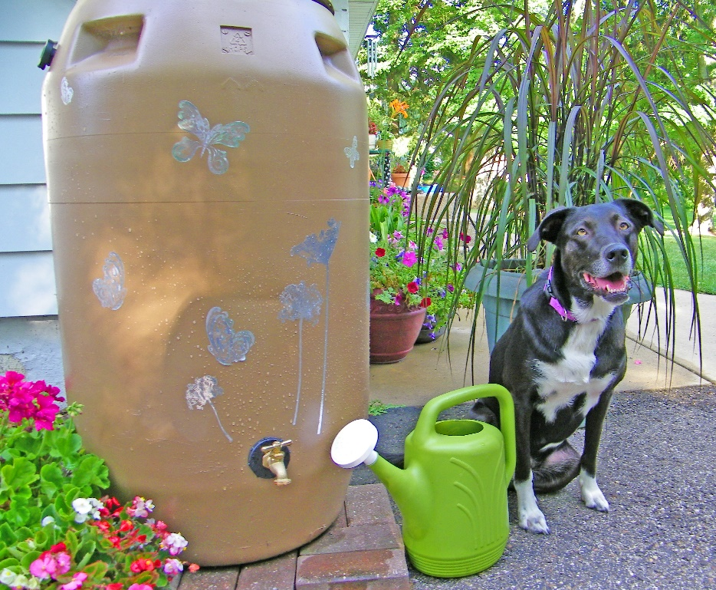
Urban Conservation
We are a resource for citizens and landowners to learn about and implement conservation practices, especially rain gardens and rain barrels.
Notes:
Left picture (credit: Elkhart Co SWCD): Students painting a rain barrel in Goshen, IN
Top Right (credit: Elkhart Co SWCD): Newly planted rain garden in Elkhart County, IN
Bottom Right (credit: Elkhart Co SWCD): Installed rain barrel in Elkhart County IN

Slide 22
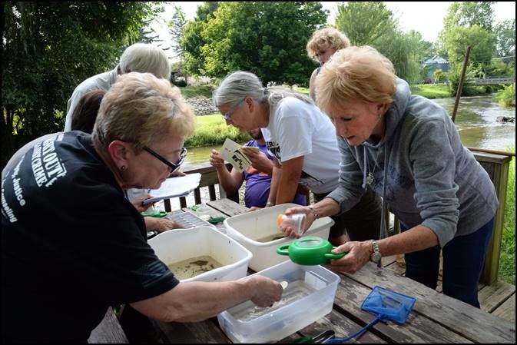
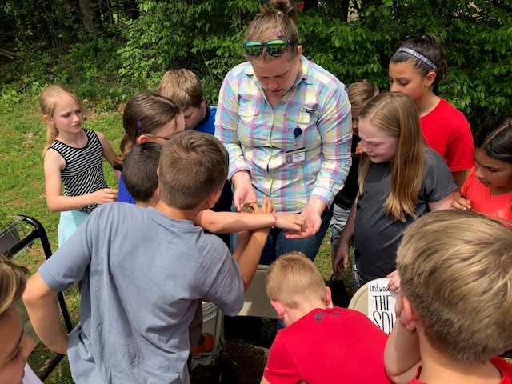
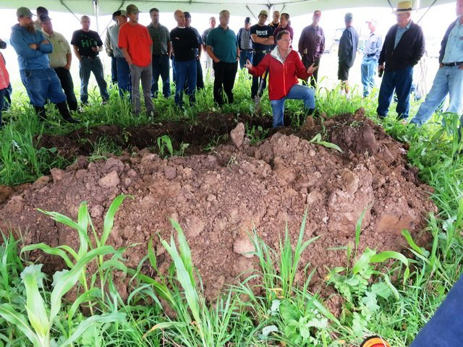
Conservation Education
We provide educational opportunities and materials for adults and K-12 students.
Notes:
Top Picture: (Credit: G. Salavarria) Indiana Master Naturalists learning about benthic macroinvertebrates
Right Picture: (Credit: Elkhart Co SWCD) J Beehler teaching worms and soil health to elementary students
Bottom Picture: (Credit: Elkhart Co SWCD) H Kok teaching soil health to area farmers at SWCD workshop

Slide 23
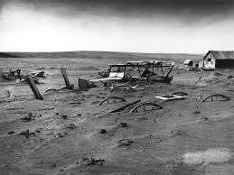
Soil conservation efforts were born in a time of natural disaster and economic hardship
Today, our nation is facing challenges to produce enough food and fiber for an ever-growing population without depleting our natural resources.

Slide 24
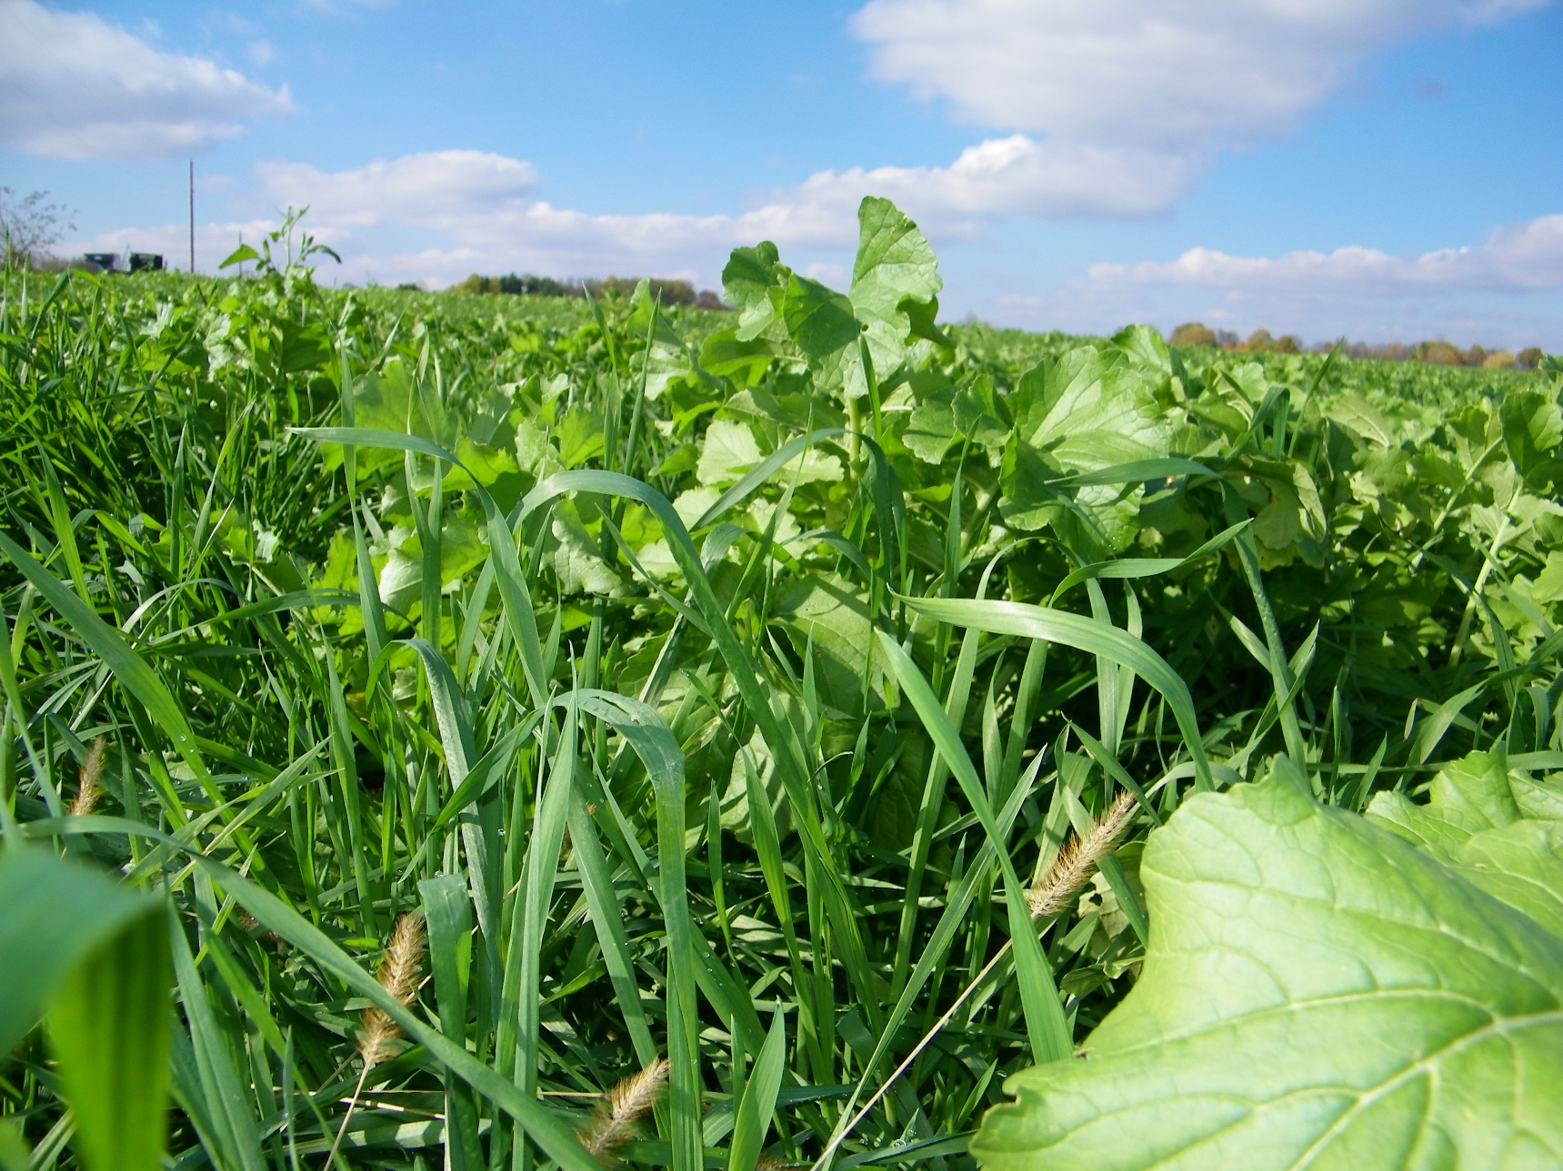
By working together to educate others and ourselves, we can leave a healthy and productive environment for the next generation.
Notes:
Photo: (Credit: Elkhart Co SWCD) Cover crop mix in spring in Elkhart County

Slide 25
Explore these links and the “notes” section below each slide for background information
Learn More!

Slide 26
Supporting Information, Resources, and Classroom Activities
7th-12th Grade:
http://www.pbs.org/kenburns/dustbowl/educators/lesson-plans/
“Whirlwind” Activity Ideas for All Grades:
http://www.pbs.org/kenburns/dustbowl/educators/whirlwind-activities/
More Information from Ken Burns’ PBS Special:
http://www.pbs.org/kenburns/dustbowl/about/overview/
US Department of Agriculture Natural Resource Service historical pieces:
https://www.nrcs.usda.gov/wps/portal/nrcs/detail/national/about/history/?cid=nrcs143_021383
https://www.nrcs.usda.gov/wps/portal/nrcs/main/national/about/history/
https://www.nrcs.usda.gov/wps/portal/nrcs/detail/national/about/history/?cid=nrcs143_021395
Notes:
The best resource for Dust Bowl activities, lesson ideas, and background information is from the PBS Special by Ken Burns
The USDA-NRCS also has historical accounts of the why, the who, and the when the agency was formed.

Slide 27
Still want to know more?
Contact us!
Elkhart County Soil and Water Conservation District
17746-B County Road 34
Goshen, IN 46528
574-533-4383 ext 3
www.elkcoswcd.org
Notes:
Thank you, contact us any time!
We are available to come and do presentations as well as provide more background information and/or lesson planning support for educators in Elkhart County!

