Slide 1
Reducing Stormwater with Trees and Native Plants
In Urban Areas
Updated 3/2019
Based on City of Franklin, IN Storm Water Education Program
Notes:
Recommended that you review Stormwater Basics powerpoint first

Slide 2
Learning Objectives
What are the challenges of urban stormwater management?
What are the benefits of trees in an urban setting?
What are the ecosystems services provided by trees in an urban environment?
What are the economic, social, ecological, and aesthetic benefits of trees within cities?

Slide 3
Stormwater
Stormwater is a term used to describe water that originates during precipitation events. It may also be used to apply to water that originates with snowmelt or runoff water from overwatering that enters the stormwater system. Stormwater that does not soak into the ground becomes surface runoff, which either flows directly into surface waterways or is channeled into storm sewers, ditches, culverts which eventually discharge to surface waters.
Stormwater is of concern for two main issues: one related to the volume and timing of runoff water ( flood control and water supplies) and the other related to potential contaminants that the water is carrying, i.e. water pollution.
Notes:
https://www.epa.gov/npdes/npdes-stormwater-program
https://goshenindiana.org/stormwater-management

Slide 4
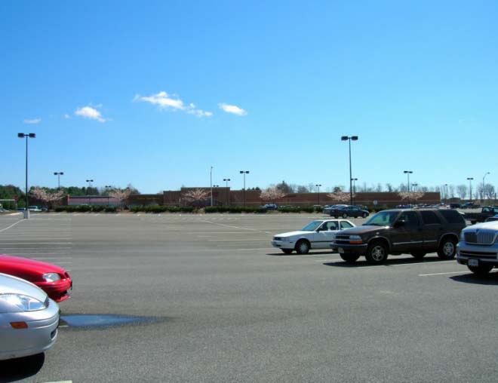
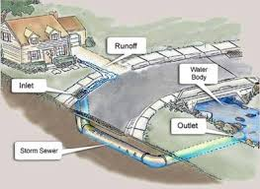
Stormwater Management Challenges for Urban Settings
Impermeable surfaces and compacted soils
leads to
Decreased infiltration and Increased runoff
Notes:
http://extension.udel.edu/factsheets/permeable-vs-impermeable-surfaces/

Slide 5
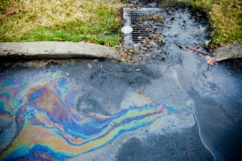
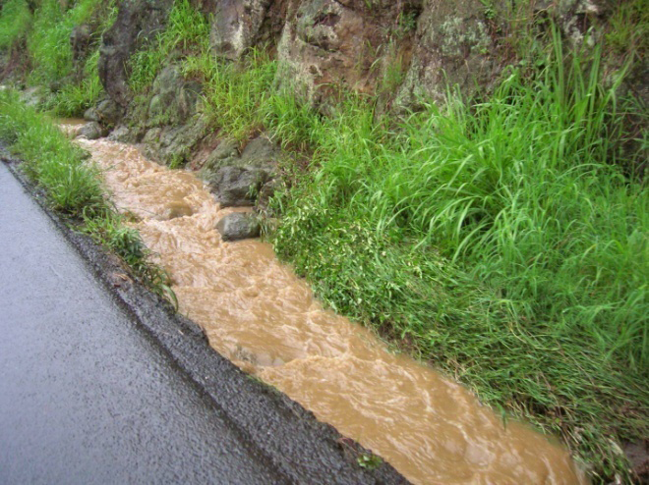
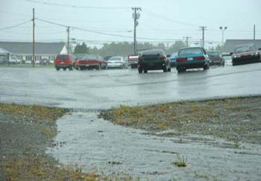
Stormwater Management Challenges for Urban Settings
Paved Surfaces
No groundwater recharge
Cannot store water
Inhospitable to plant life
Pollution laden runoff

Slide 6
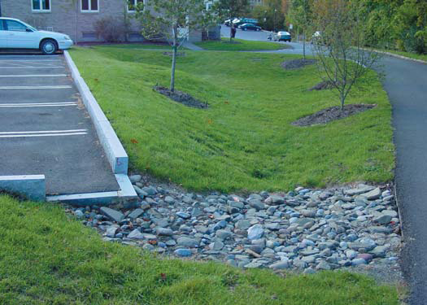
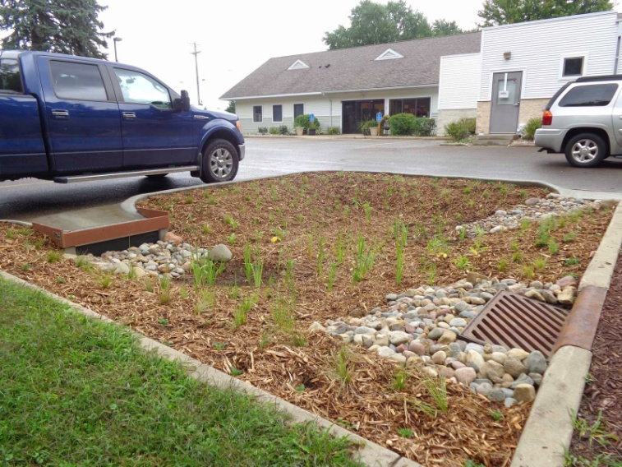
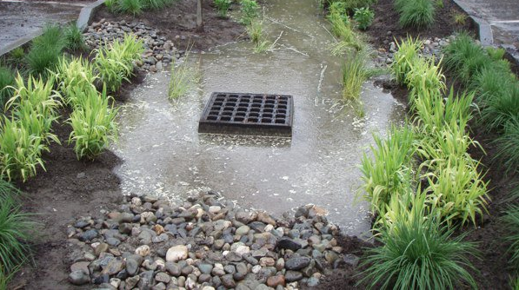
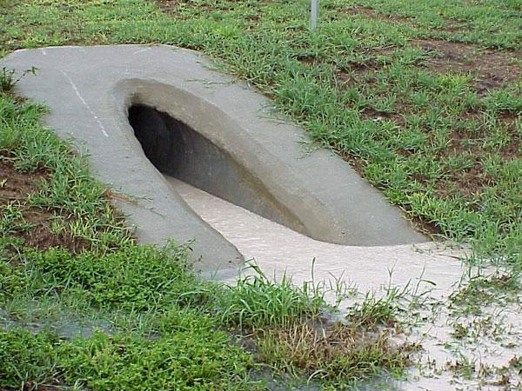
Challenges of Common Stormwater Practices Infiltration Infrastructure
Concentrated stormwater
=
higher risk of contaminated water
Notes:
http://indiana.clearchoicescleanwater.org/

Slide 7
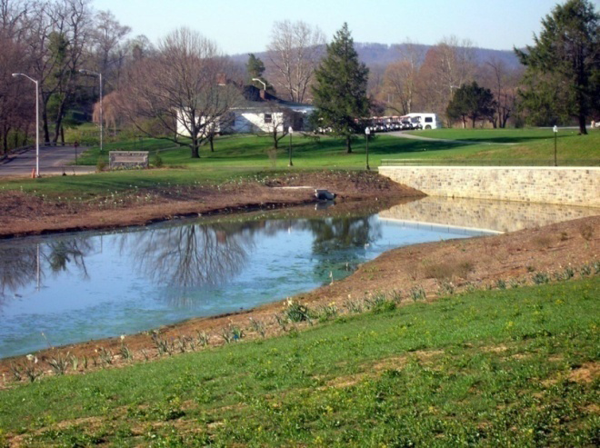
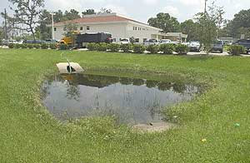
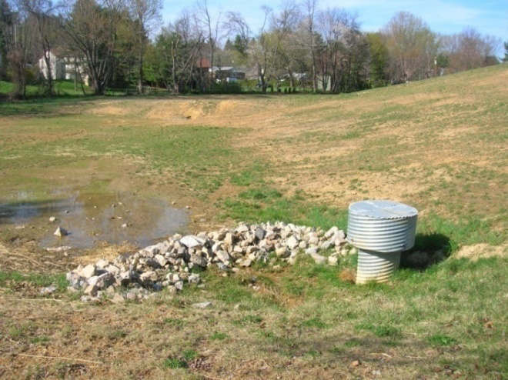
Challenges of Common Stormwater Practices Detention and Retention Ponds
Take up open space
Lack distributed infiltration
Issues with safety, pests, & aesthetics

Slide 8
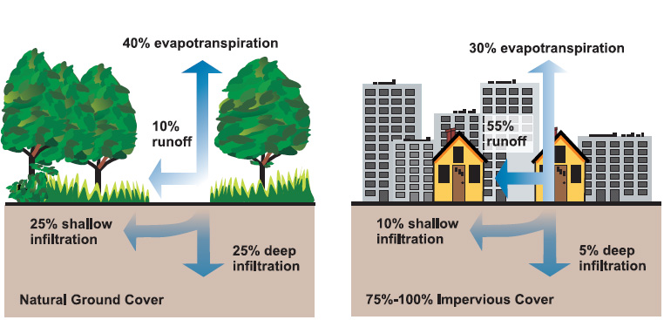
Stormwater Management The Role of Trees
We can’t mimic pre-development hydrologic cycles WITHOUT plants!

Slide 9
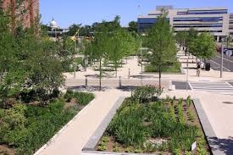
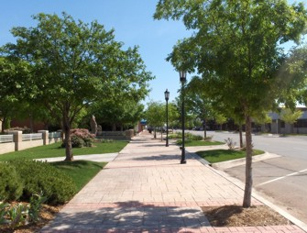
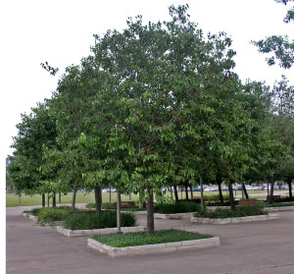
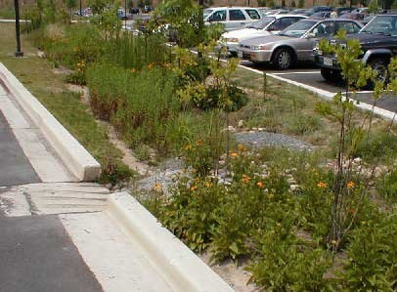
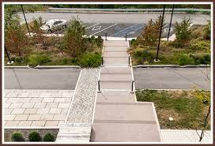
How do we do it? Incorporating Trees into Stormwater Management
Design to mimic the natural processes provided by native vegetative cover!
Notes:
Have you heard of Low Impact Design (LID)?
Low Impact Development (LID) is an ecologically-based stormwater management approach favoring soft engineering to manage rainfall on site through a vegetated treatment network. The goal of LID is to sustain a site’s pre-development hydrologic regime by using techniques that infiltrate, filter, store, and evaporate stormwater runoff close to its source. Contrary to conventional “pipeand-pond” conveyance infrastructure that channels runoff elsewhere through pipes, catchment basins, and curbs and gutters, LID remediates polluted runoff through a network of distributed treatment landscapes.
http://www.bwdh2o.org/wp-content/uploads/2012/03/Low_Impact_Development_Manual-2010.pdf

Slide 10
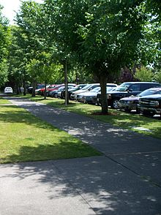
Benefits of Trees Reduction of Urban “Heat Island” Effect
Water evaporating
from leaves cools air
Block sunlight, causing shade which cools hard surfaces and surface water
Natural air conditioning!

Slide 11
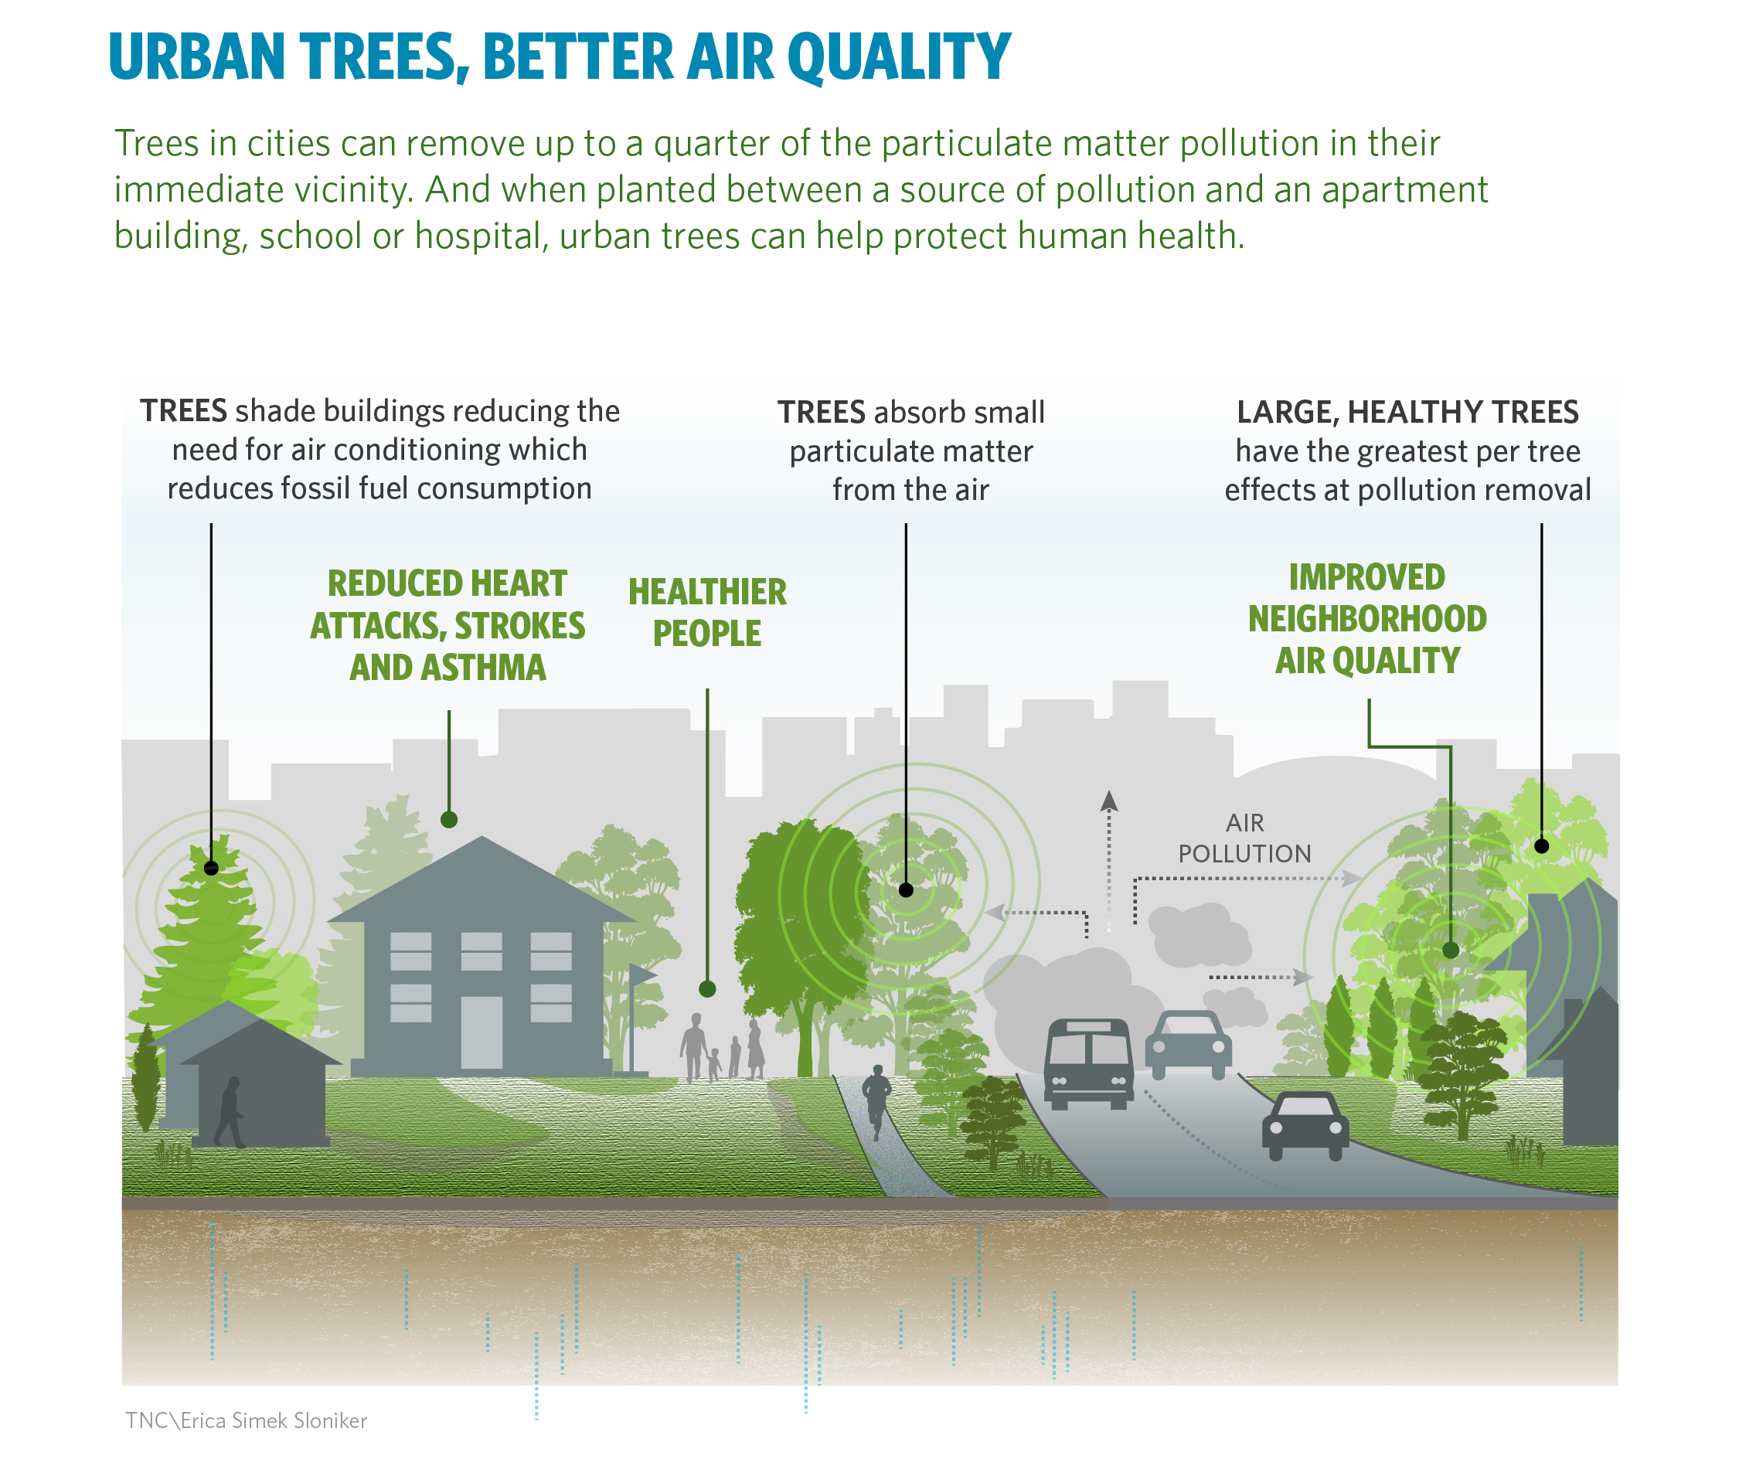
Benefits of Trees Reduction of Air Pollution
Notes:
https://actreesnews.org/featured/urban-trees-can-save-lives-by-reducing-air-pollution-and-temperature/

Slide 12
Benefits of Trees Ecosystem Services
Provide habitat and food for wildlife and insects
Fallen and decaying leaves provide nutrients, reduce soil temperature and soil moisture, and increase soil health
Notes:
https://www.fs.fed.us/psw/publications/mcpherson/psw_2016_mcpherson001_livesley.pdf

Slide 13
Benefits of Trees Economic Benefits: City of Goshen
https://www.youtube.com/watch?v=1nHLOrdtw0o
Follow the link above to hear from the City of Goshen how trees have an economic impact on urban spaces.

Slide 14
Benefits of Trees Social Benefits: City of Goshen
https://youtu.be/HrCwHYDvhk0
Follow the link above to hear from the City of Goshen how trees have an social impact on urban spaces.

Slide 15
Benefits of Trees Ecological Benefits: City of Goshen
https://youtu.be/f9vQWwwpgCQ
Follow the link above to hear from the City of Goshen how trees have an ecological impact on urban spaces.

Slide 16
Benefits of Trees Aesthetic Benefits: City of Goshen
https://youtu.be/X0VOFWv20JU
Follow the link above to hear from the City of Goshen how trees have an aesthetic impact on urban spaces.

Slide 17
Explore these links and the “notes” section below each slide for background information
Learn More!

Slide 18
Supporting Information, Resources, and Classroom Activities
Want to borrow an Enviroscape model? It shows stormwater pollution from all different sources and is perfect to use as a demonstration in your classroom!
https://web.uri.edu/riss/files/Envir_lesson_teacher.pdf
You can borrow ours for your classroom!
Lesson Plans for Low Impact Development
https://serc.carleton.edu/integrate/teaching_materials/ecosystem_water/unit2.2.html
Best Management Practices for Stormwater
https://www.epa.gov/npdes/national-menu-best-management-practices-bmps-stormwater#edu
Background information on stormwater BMPs
Notes:
Links checked as of 3/25/2019

Slide 19
Elkhart County Soil and Water Conservation District
17746-B County Road 34
Goshen, IN 46528
574-533-4383 ext 3
www.elkcoswcd.org
Still want to know more? Contact us!

