Slide 1
Stormwater 101
The Greater Elkhart County Stormwater Partnership
Updated 3/2019
Based on City of Franklin, IN Storm Water Education Program

Slide 2
Learning Objectives
What is the Greater Elkhart County Stormwater Partnership?
What is a MS4?
What is stormwater?
Why is managing stormwater important?

Slide 3
The Greater Elkhart County Stormwater Partnership
What is a MS4 and how does it work?

Slide 4
MS4 and The Greater Elkhart County Stormwater Partnership
MS4
stands for
Municipal Separate Storm
Sewer Systems
This partnership includes: Elkhart County
City of Elkhart
City of Goshen
Town of Bristol
Notes:
Stormwater utilities are also referred to MS4’s or Municipal Separate Storm Sewer Systems. MS4’s are designated entities that utilize conveyances for rainwater such as road with drainage systems, municipal streets, curbs, gutters, ditches or storm drains.
Largers municipalities may have MS4 utilities structured in different ways within their city’s operation, the responsibilities and compliance to federal and state regulations remain the same. In Elkhart County, our MS4 coordinator resides in a county office and oversees the Greater Elkhart County Stormwater Partnership
FROM THE SWCD Website (https://www.elkcoswcd.org/greater-elkhart-county-stormwater-partnership/):
The Greater Elkhart County Stormwater Partnership is a cooperative effort to implement the Municipal Separate Storm Sewer System (MS4) plan of four local government entities in Elkhart County, Indiana:
Town of Bristol || City of Elkhart || City of Goshen || Elkhart County
The plan includes six minimum control measures and outlines programs to improve the quality of stormwater that runs off of land and into rivers, lakes, and streams.
The Elkhart County Stormwater Board (composed of the three County Commissioners and the County Surveyor) meetings are scheduled for the fourth Monday of each month and held at the Elkhart County Government Administration Building at 117 North Second Street in Goshen, immediately following the Elkhart County Commissioners 9:00am. The MS4 Advisory Board meetings (composed of the Stormwater Partnership entities) are scheduled for the second Wednesday of every month at 1:00pm.
Contact John Heiliger, Stormwater Coordinator, to have items added to either Elkhart County Stormwater Board meetings or the Greater Elkhart County Stormwater Partnership Board meetings.
Each entity is responsible for Post Construction Stormwater Run-off, and Municipal Operations Pollution Prevention and Good Housekeeping within their jurisdiction. If you are looking for information that is specific to an individual entity, please click on their link below:
Bristol City of Elkhart City of Goshen Elkhart County

Slide 5
MS4 and The Greater Elkhart County Stormwater Partnership
Guidance Documentation
The Federal Clean Water Act requires storm water discharges from certain types of urbanized areas to be permitted under the National Pollutant Discharge Elimination System (NPDES) program.
November 1990 – EPA began Phase I of its storm water program requiring states to develop regulatory programs to address pollution issues associated with storm water.
Today Storm Water Phase II has been established to reduce the impacts of storm water run-off from construction, industrial, municipal, governmental and institutional sources.
General Storm Water rules are found in 325 IAC 15 (Article 15).
August 2003 - 327 IAC 15-13 (Rule 13) established requirements for designated MS4’s entities to develop local Storm Water Quality Management Plans (SWQMP).
Notes:
These are the acts, laws, rules, and policies that the MS4 and the Greater Elkhart County Stormwater Partnership have to follow.

Slide 6
MS4 and The Greater Elkhart County Stormwater Partnership
SWQMP
Storm Water Quality Management Plans
The MS4’s must address these 6 “minimum control measures”
through their SWQMP
Public Education and Outreach
Public Participation and Involvement
Illicit Discharge Detection and Elimination
Construction Site Runoff Control
Post-Construction Site Runoff Control
Pollution Prevention and Good Housekeeping
Notes:
Each entity of the Greater Elkhart County Stormwater Partnership assists with different minimum control measures.

Slide 7
MS4 and The Greater Elkhart County Stormwater Partnership
Rule 5: SWPPPs
(Storm Water Pollution Prevention Plan)
327 IAC 15-5 a.k.a. Rule 5
is a performance-based state regulation designed to reduce polluntants that are associated with construction and/or land disturbing activities
LONG STORY SHORT
If someone disturbs more than one (1) acre of soil while developing land (not agriculture), they are regulated by a state rule and must have a storm water control and erosion prevention plan in place
Notes:
The MS4 Coordinator for each entity has the ability to stop construction until problems are resolved.
The most common complaint from construction sites in Elkhart County is sediment on the roadway from heavy equipment tires.
The take home point is that someone is watching when soil gets disturbed and moved around.
For more information on 327 IAC 15-5 visit: https://www.in.gov/idem/stormwater/2331.htm (link checked 3/21/19)

Slide 8
Stormwater
What is it and what do we do to control it?

Slide 9
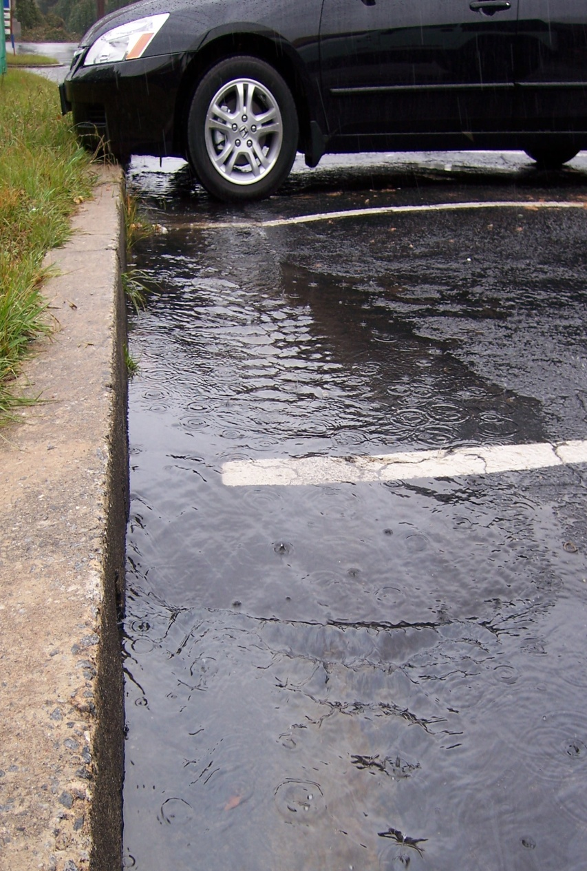
What is stormwater?
Stormwater is water that originates from precipitation events, snowmelt, or runoff
Stormwater is urban and agricultural – rain falls everywhere!
Notes:
Stormwater is a term used to describe water that originates during precipitation events. It may also be used to apply to water that originates with snowmelt or runoff water from overwatering that enters the stormwater system. Stormwater that does not soak into the ground becomes surface runoff, which either flows directly into surface waterways or is channeled into storm sewers, ditches, culverts which eventually discharge to surface waters.
Stormwater is of concern for two main issues: one related to the volume and timing of runoff water ( flood control and water supplies) and the other related to potential contaminants that the water is carrying, i.e. water pollution.

Slide 10
How is stormwater managed?
The Greater Elkhart County Stormwater Partnership works diligently to:
Control flooding by installing, cleaning, and maintaining stormwater infrastructure such as curbs and gutters, street inlets, pipes, ditches, culverts, detention ponds, etc.
Regulate development by setting design standards, providing technical guidance, reviewing plans for development and redevelopment, inspecting construction sites, and enforcing regulations.
Prevent pollution by educating the public, implementing clean water programs, inspecting and monitoring runoff, complying with federal and state regulations, and enforcing water quality standards set by the Clean Water Act.
Notes:
Under significant rainfall conditions, stormwater is the cause of flooding, water pollution and erosion. For the safety of the public and for the protection of public and private property, stormwater must be properly managed. Stormwater management, provided by the Greater Elkhart County Stormwater partnership is a very important responsibility

Slide 11
How is stormwater managed?
The Greater Elkhart County Stormwater Partnership works diligently to:
Control flooding by installing, cleaning, and maintaining stormwater infrastructure such as curbs and gutters, street inlets, pipes, ditches, culverts, detention ponds, etc.
Regulate development by setting design standards, providing technical guidance, reviewing plans for development and redevelopment, inspecting construction sites, and enforcing regulations.
Prevent pollution by educating the public, implementing clean water programs, inspecting and monitoring runoff, complying with federal and state regulations, and enforcing water quality standards set by the Clean Water Act.
Notes:
Under significant rainfall conditions, stormwater is the cause of flooding, water pollution and erosion. For the safety of the public and for the protection of public and private property, stormwater must be properly managed. Stormwater management, provided by the Greater Elkhart County Stormwater partnership is a very important responsibility

Slide 12
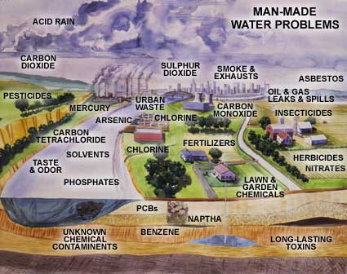
Controlling Runoff = Controlling Stormwater
The three types of runoff that contribute to controlling stormwater quality are:
Rural Runoff.
Urban Runoff
Suburban Runoff
Unregulated urban industrial areas can contribute to heavy metal and toxic pollutants.
Did you know that sediment, fertilizers and other chemicals are a result of farming? Even with pervious soils.
Can you believe you pollute at home with fertilizers, phosphates and even your litter too?

Slide 13
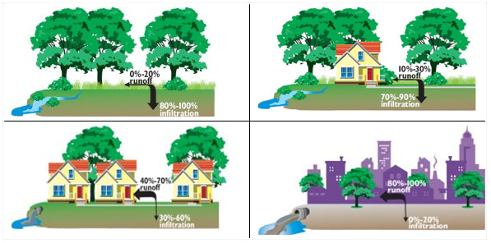
Rural, Suburban, Urban, and Industrial Runoff Estimates
Industrial and Urban have the most runoff, and the smallest amount of infiltration

Slide 14
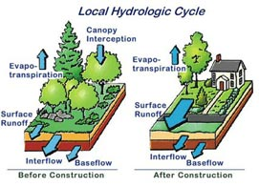
Urban Runoff
Notes:
Urban runoff is surface runoff or rainwater created by urbanization. This runoff is a major source of water pollution in many parts of the United States and other urban communities worldwide.
Impervious surfaces (roads, parking lots and sidewalks) are constructed during land development. During rain storms and other precipitation events, these surfaces (built from materials such as asphalt, cement, and concrete), along with rooftops, carry polluted stormwater to storm drains, instead of allowing the water to percolate through soil This causes lowering of the water table (because ground recharge is lessened) and flooding since the amount of water that remains on the surface is greater. Most municipal storm sewer systems discharge stormwater, untreated, to streams, rivers and bays.

Slide 15
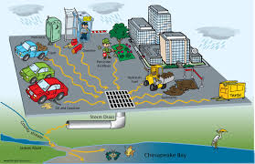
Urban Runoff Pollutants
Can you identify any sources of pollutants in these two urban areas?
Notes:
Water running off these impervious surfaces tends to pick up gasoline, motor oil, heavy metals, trash and other pollutants from roadways and parking lots, as well as fertilizers and pesticides from lawns. Roads and parking lots are major sources of polycyclic aromatic hydrocarbons (PAHs), which are created as combustion byproducts of gasoline and other fossil fuels, as well as of the heavy metals nickel, copper, zinc, cadmium and lead. Roof runoff contributes high levels of synthetic organic compounds and zinc (from galvanized gutters). Fertilizer use on residential lawns, parks and golf courses is a significant source of nitrates and phosphorus.
As stormwater is channeled into storm drains and surface waters, the natural sediment load discharged to receiving waters decreases, but the water flow and velocity increases. In fact, the impervious cover in a typical city creates five times the runoff of a typical woodland of the same size.

Slide 16
Explore these links and the “notes” section below each slide for background information
Learn More!

Slide 17
Supporting Information, Resources, and Classroom Activities
Landscape Architecture/Stormwater Management Lesson Plan Book
https://cbtrust.org/wp-content/uploads/EPA-SW-Lesson-Plan-Book.pdf
Great resource for lesson plans grade 3-12
Teacher Resources for Introducing Urban Stormwater Quality Concepts to the Classroom
https://www.colorado.gov/pacific/sites/default/files/WQ_Teacher-Resources.pdf
Lesson plans following Colorado standards, but applicable activities and info
Best Management Practices for Stormwater
https://www.epa.gov/npdes/national-menu-best-management-practices-bmps-stormwater#edu
Background information on stormwater BMPs
Notes:
Links checked as of 3/21/2019

Slide 18
Elkhart County Soil and Water Conservation District
17746-B County Road 34
Goshen, IN 46528
574-533-4383 ext 3
www.elkcoswcd.org
Still want to know more? Contact us!

