Slide 1
Citizen Science with Hoosier Riverwatch
Volunteer Water Monitoring and Available Data
Updated 11/2018
Notes:
Citizen Science with Hoosier Riverwatch: Volunteer Water Monitoring and Available Data
Prepared by the Elkhart County Soil and Water Conservation District
Presented for the Indiana Watershed Leadership Academy 1/10/2019

Slide 2
Learning Objectives
Do You Know?
What is citizen science?
What is Hoosier Riverwatch?
What data is publicly available to use?
How can you get involved in Hoosier Riverwatch?
Notes:
Learning Objective: Learn more in the following slides
Overview/Purpose: This powerpoint serves as informational. It is an overview of the citizen science efforts through Hoosier Riverwatch, which includes a brief about what Hoosier Riverwatch is all about. This most importantly includes where to find and how to use publicly available Hoosier Riverwatch data.

Slide 3
What is Hoosier Riverwatch?
Mission:
To involve citizens of Indiana in becoming active stewards of Indiana’s water resources through watershed education, water monitoring, and clean-up activities.
Notes:
Hoosier Riverwatch is housed in Indiana Dept. of Environmental Management (IDEM) Office of Water Quality, Watershed Assessment and Planning Branch.
The program began in 1996.

Slide 4
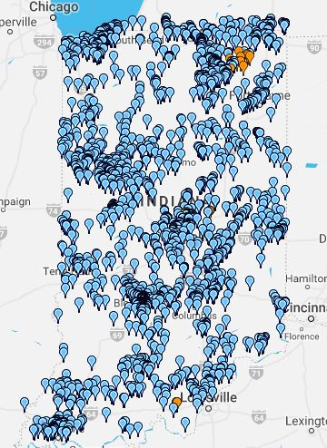
What is Hoosier Riverwatch?
Volunteer Water Monitoring
Citizen Science Project
Education and Outreach
Involvement and Awareness
Notes:
Picture: Screen shot of monitoring sites (http://www.hoosierriverwatch.com/; 14 DEC 2018)
Hoosier Riverwatch volunteers and citizen scientists collect physical, chemical, and biological data at sites in their community.
WOAH that’s a lot of data, what type of data is collected?
Physical
Chemical
Biological

Slide 5
Observe and Record:
Substrate (bottom of water body)
Fish Cover (hiding places)
Stream Shape/Human Alterations
Stream Forests, Wetlands, and Erosion
Depth and Velocity
Riffles/Runs
Physical Data
Citizens Qualitative Habitat Evaluation
(CQHEI)
Notes:
The CQHEI is based on observations that are assigned a point value. Those observations are listed above.
You can find the CQHEI and supporting habitat evaluation material at: https://www.in.gov/idem/riverwatch/files/volunteer_monitoring_manual_chap_3.pdf (copy and paste link)

Slide 6
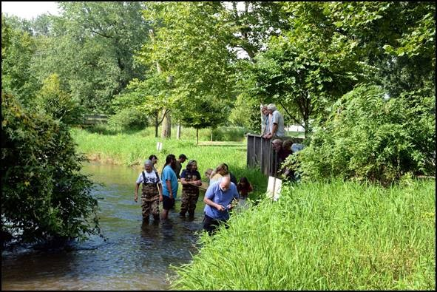
Physical Data
Citizens Qualitative Habitat Evaluation
(CQHEI)
Notes:
Picture: Little Elkhart at Riverbend Park, Middlebury IN (PC: Elkhart County SWCD, G. Salavarria)
CQHEI scores: Substrate [a)Mostly medium, 10pts. b) No smothering, 5pts. c) no silting, 5pts]
Fish Cover [Shrubs/small trees, backwaters/oxbows/sidechannels, shallow/slow areas, water plants, deep areas, undercut banks, 12 pts total]
Stream Shape[a) 1-2 good bends, 6pts. B) many man-made, 6pts
Streams Forests and Wetlands [
Walk through habitat score of this site by following CQHEI worksheet

Slide 7
Dissolved Oxygen
pH
Biochemical Oxygen Demand
Orthophosphate
E. Coli and coliform bacteria
Water Temperature Change
Nitrate and Nitrite
Turbidity
Chemical Data
Caution: The HRW protocol for chemical testing is not standardized.
It’s still useful!
Notes:
HRW does not require volunteers to use a single method or standard set of equipment for chemical monitoring. This leads to discrepancies in data and information about chemical properties of sites can only be used to identify priority areas for further testing – unless you know the volunteer and protocol they use.
Even though testing is not standardized (and therefore not recommended for official use), you CAN utilize this data to identify priority areas for further testing, visualize general trends in your watershed/county/area, and push outreach/education/awareness.
More information and chemical monitoring data sheets can be found at: https://www.in.gov/idem/riverwatch/files/volunteer_monitoring_manual_chap_4.pdf (copy and paste link)

Slide 8
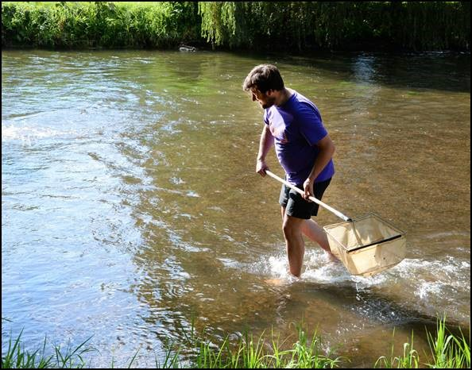
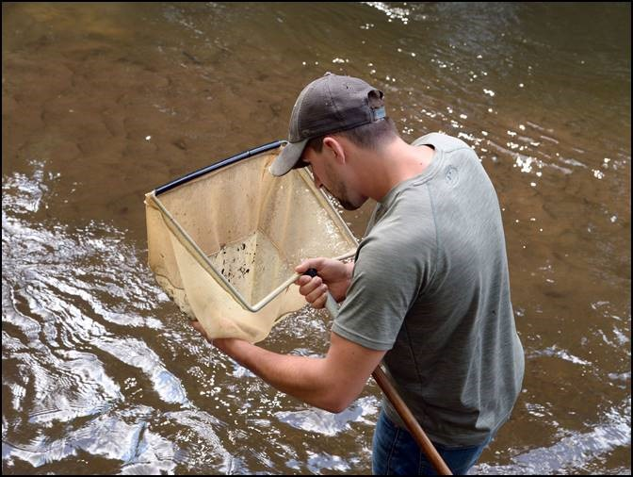
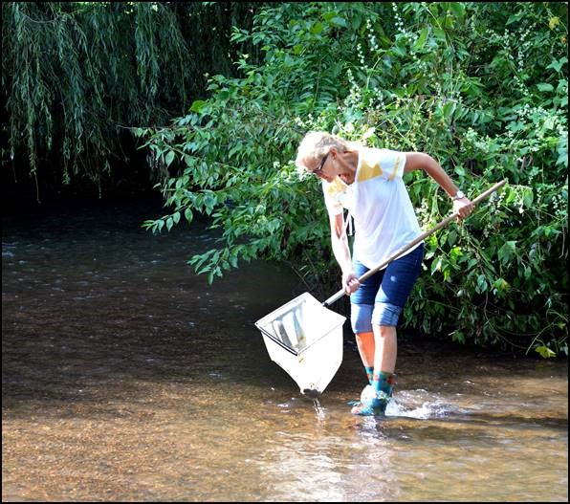
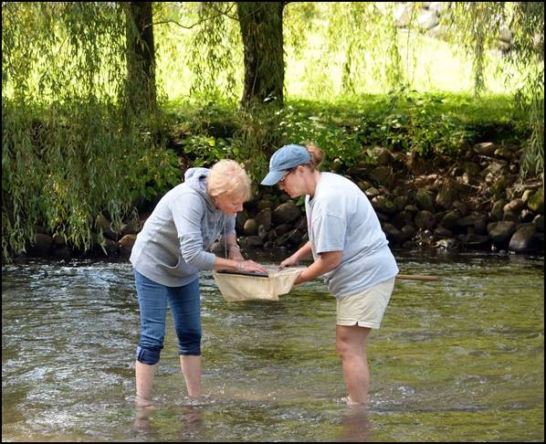
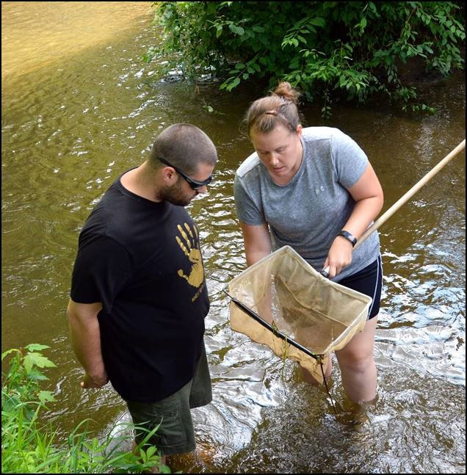
Benthic Macroinvertebrate Collection
Biological Data
Macroinvertebrates!
Most fun part!
Notes:
Pictures: 2018 Elkhart County Indiana Master Naturalist class collecting macros (PC: Elkhart Co SWCD, G. Salavarria)
What are macros?
spend most of their time underwater (benthic)
big enough to be seen with eye (macro)
without a spine (invertebrate)
Why macros?
Easy to sample, usually plentiful
Immobile – indicator of water quality
Continuous indicator of water quality (not a point sample, populations change over a longer time)
Fit in the food web, indicator of other species
More information about benthic macroinvertebrates at: https://www.in.gov/idem/riverwatch/files/volunteer_monitoring_manual_chap_5.pdf (copy and paste link)

Slide 9
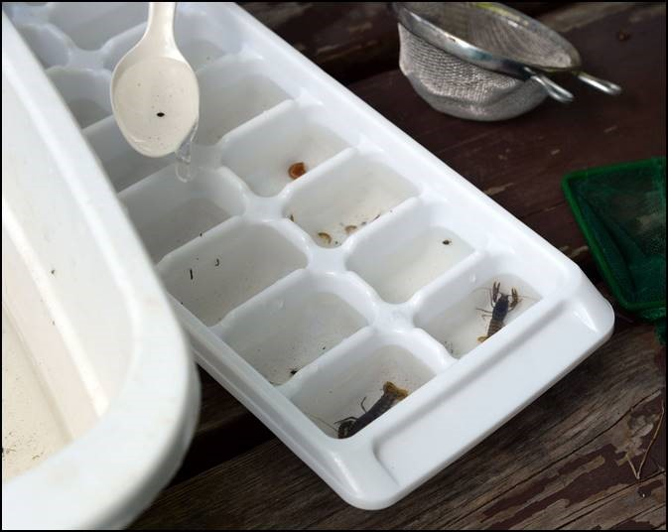
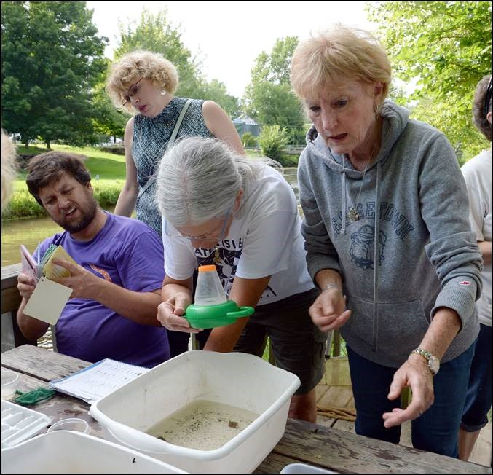
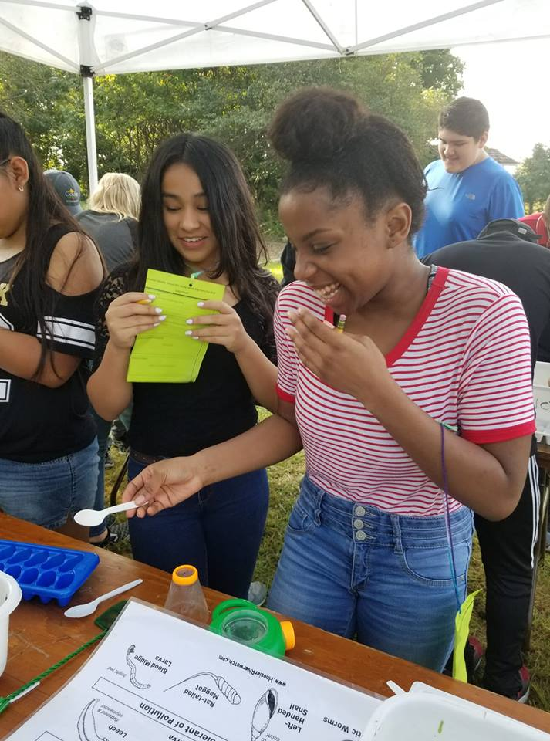
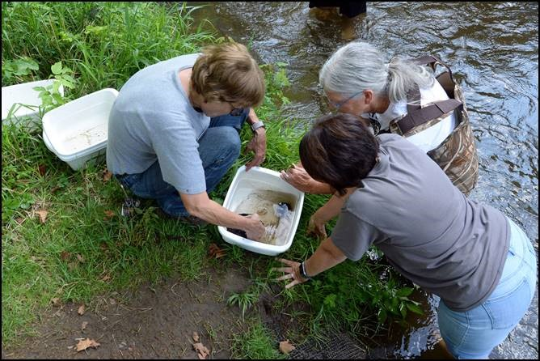
Benthic Macroinvertebrate Identification
Biological Data
Macroinvertebrates!
Most fun part, hands down.
Notes:
*This is an activity we can bring into your classroom or we can include it on a field trip*
Pic Bottom Left: Middle school students interact and IDs macros (PC: Elkhart Co. SWCD)
Pic Top Left and both Right: 2018 Indiana Master Naturalist Class IDs macros (PC: Elkhart Co. SWCD, G. Salavarria)
After macros are scooped up by nets, put them in tubs and then take them to a table or workspace
Organize them with ice cube trays
Plastic spoons work the best to “grab” the macros
ID species
ID tolerance level/fill out HRW bio sheet
BEST THING – people don’t realize how many little critters are living in the water and that they are such good indicators of water quality. Great experience even if not taking actual data. Gets people thinking about their impact on more than just fish and frogs, there’s so much more living in the water. Many have come back and said they go out and explore/find macros on their own just because they’re curious and don’t think those could possible be living in their pond/ditch/creek/river. They always find some.
More information about benthic macroinvertebrates at: https://www.in.gov/idem/riverwatch/files/volunteer_monitoring_manual_chap_5.pdf (copy and paste link)

Slide 10
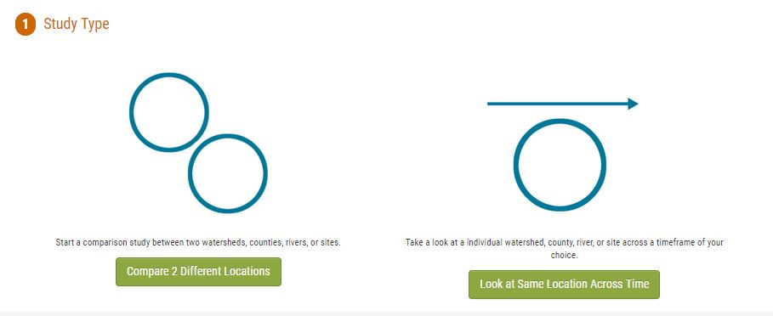
Data!
Data collected through HRW is publicly available.
There’s also a nifty visualization tool for general observations.
Notes:
http://www.hoosierriverwatch.com/visualize (Screenshot 12 DEC 2018)
The visualization tool helps you get an idea of the data available in your watershed, as well as the quality. You can choose to look at one location or compare
Students can use this data to compare watershed areas or compare one watershed area over time.

Slide 11
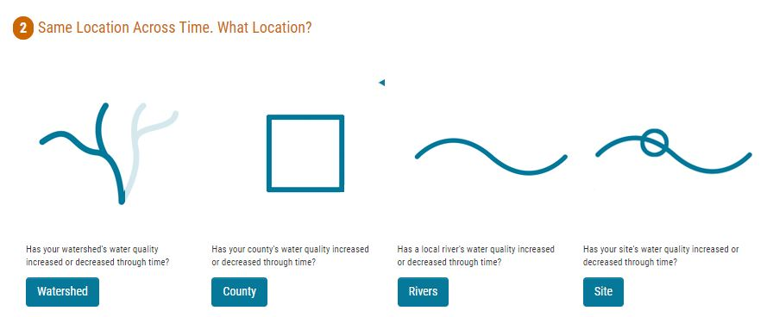
Data!
Data collected through HRW is publicly available.
There’s also a nifty visualization tool for general observations.
Notes:
http://www.hoosierriverwatch.com/visualize (Screenshot 12 DEC 2018)
Next, you choose the area that you want to look at

Slide 12
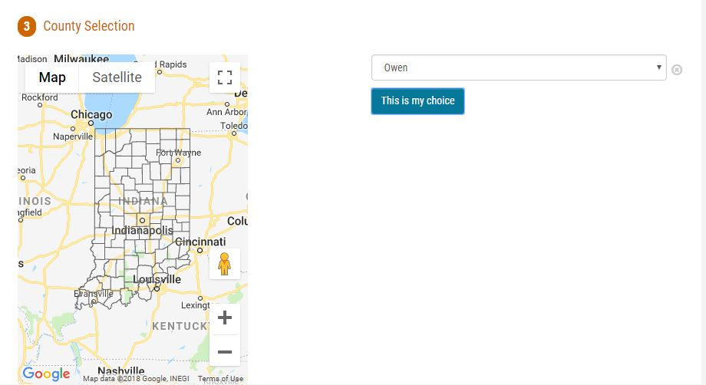
Data!
Data collected through HRW is publicly available.
There’s also a nifty visualization tool for general observations.
Notes:
http://www.hoosierriverwatch.com/visualize (Screenshot 12 DEC 2018)
I choose to look by county

Slide 13
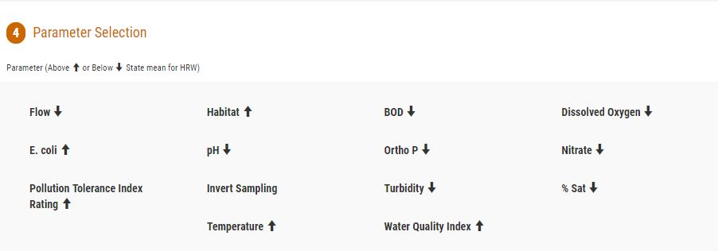
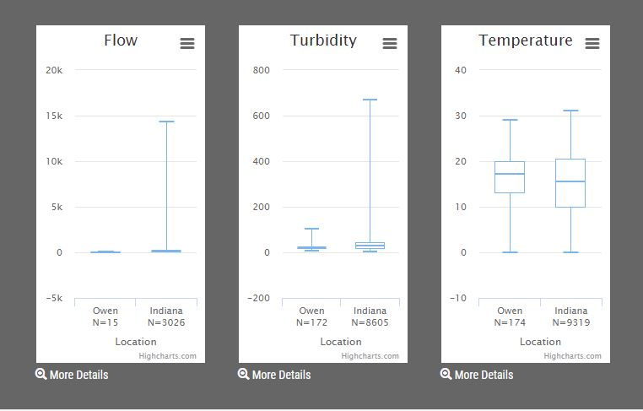
Data!
Data collected through HRW is publicly available.
There’s also a nifty visualization tool for general observations.
Notes:
http://www.hoosierriverwatch.com/visualize (Screenshot 12 DEC 2018)
You get an overview of variables and by clicking on them, graphs are generated

Slide 14
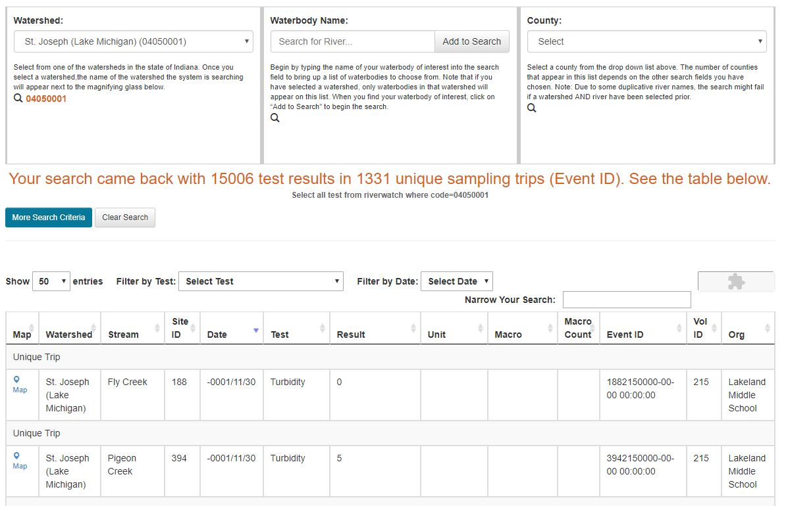
Data!
Data collected through HRW is publicly available.
You can also get the raw data.
Notes:
http://www.hoosierriverwatch.com/visualize (Screenshot 12 DEC 2018)
Each unique trip is logged when citizen scientist volunteers submit their data to the website.
This “raw data” can be used to generate your own graphs, test hypothesis, etc.

Slide 15
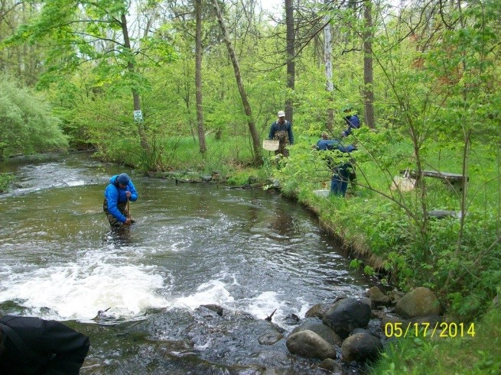
Data!
Starting point
ID Priority Areas
Build volunteer network
How should you use this information?
Notes:
IDEM does not use this data officially. They send out their own people to do monitoring and pre-determined locations.
But it’s available to use as an indicator, starting point, reference, jumping off point
Get people involved in water quality, ID priority areas for management or further study, building a network of volunteers, encourage citizen science

Slide 16
I like data and information! This sounds like a great thing to start on my creek!
Notes:
Time to start a citizen science water monitoring program! ☺
School groups can also get involved to monitor sites near their school

Slide 17
How to Get Trained and Start Monitoring
Instructors in Elkhart County are housed at the Elkhart County Parks and the Elkhart County SWCD
Give us a call to see when our next training workshop is or schedule one for a group at your school or organization!
Elkhart County Parks: 574-535-6458
Elkhart County SWCD: 574-533-4383 ext 3
Notes:
Elkhart County instructors are housed at the Elkhart County Parks and the Elkhart County SWCD
Instructors are spread out across the state and regularly hold volunteer trainings
To become an instructor, you have to contact Carol and travel to Indy for a training
https://www.in.gov/idem/riverwatch/files/facilitator_map.pdf
Either way, contact Carol and she can put you on the right path
As a volunteer or non-profit, you get a loaner trunk full of supplies. Supplies are restocked through IDEM

Slide 18
Explore these links and the “notes” section below each slide for background information
Learn More!

Slide 19
Supporting Information, Resources, and Classroom Activities
The complete Hoosier Riverwatch Training and Instructors Manual:
https://www.in.gov/idem/riverwatch/2332.htm
Hoosier Riverwatch Data:
http://www.hoosierriverwatch.com/
Lesson Plans from Project WET:
https://www.projectwet.org/teach-and-learn/lesson-plans
Local Water Monitoring and Watershed Plans from the St. Joseph River Basin Commission:
http://www.sjrbc.com
Notes:
Hoosier Riverwatch has an IDEM hosted website, where the training manual can be found. The training manual has loads of background information on each subject area of monitoring.
Hoosier Riverwatch also has their own site, where the data is publicly available.
Project WET is a teacher training/professional development opportunity (both Elkhart County Parks and Elkhart County SWCD can host) but they also post lesson plans online that are related to water quality
The St Joseph River Basin Commission is a state-mandated office that oversees many watershed monitoring and cataloging efforts in Elkhart County and the surrounding counties. They are a great place to start if you are looking for local watershed, water quality, water quantity, etc. type information.

Slide 20
Still want to know more? Contact us!
Elkhart County Soil and Water Conservation District
17746-B County Road 34
Goshen, IN 46528
574-533-4383 ext 3
www.elkcoswcd.org
Notes:
Thank you, contact us any time!
We are available to come and do presentations as well as provide more background information and/or lesson planning support for educators in Elkhart County!

