Slide 1
Water Resources
in Elkhart County and Beyond
Updated 1/2019
Notes:
Water Resources in Elkhart County and Beyond
A look at the waters of Elkhart County, how we connect to the bigger world, and what we can do to protect our resources.
-----------
Prepared by the Elkhart County Soil and Water Conservation District
All links and materials correct as of January 2019

Slide 2
Learning Objectives
Do You Know?
What watershed do you live in?
Where does our drinking water come from?
Is water quality or water quantity more important in our area?
How can we protect our water resource?

Slide 3
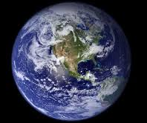
The Big Picture
Of all the water on Earth,
about 2.5% is freshwater
That 2.5% is made up of different “pools” of freshwater
Ice
Groundwater
and Soil Water
Surface Freshwater
1.8%
0.69%
0.01%
Notes:
These numbers on freshwater availability and location were averaged from many sources. Depending on what source or hydrologic modelling program used, percentages may vary slightly. We encourage you use trusted resources and do your own research!
Think about availability of the small amount of freshwater we have: ice isn’t usable, most groundwater and soil water is too expensive to obtain, cleaning surface water is also not always financially responsible.
Optional Activity - Project WET: A Drop In the Bucket
Contact the Elkhart Co SWCD for Project WET information and lesson guides

Slide 4
The Big Picture
Only about 0.003%
of the freshwater supply is available
for human consumption
Notes:
The readily and easily accessible water that is fit for human consumption, out of all the water on the Earth, only adds up to 0.003%
The rest is too far deep in the ground, too salty or dirty to clean, frozen solid, locked up in rocks, and otherwise not easy for us to get at or to pull enough quantity out of somewhere to make the cost of accessing it worth it.
We have to take care of this precious resource! And to take care of it, we must understand it

Slide 5
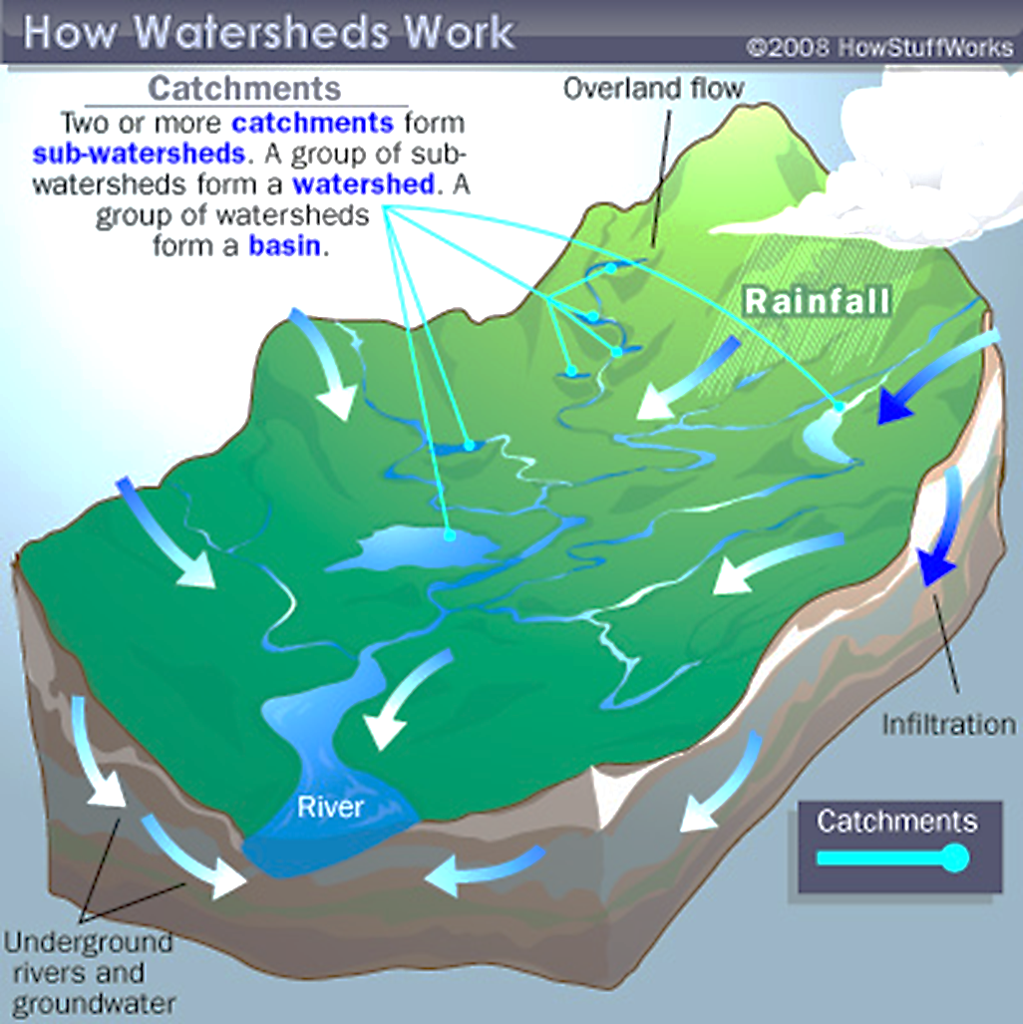
Watersheds
A watershed is the area of land where all of the water that falls in it and drains off of it goes to a common outlet
Notes:
Watersheds are classified into many different sizes. Scientists have set up a system to name and classify watershed (also called hydrologic units).
The United States is divided and sub-divided into successively smaller hydrologic units which are classified into four levels: regions, sub-regions, accounting units, and cataloging units. The hydrologic units are arranged or nested within each other, from the largest geographic area (regions) to the smallest geographic area (cataloging units). Each hydrologic unit is identified by a unique hydrologic unit code (HUC) consisting of two to eight digits based on the four levels of classification in the hydrologic unit system.
To find out more about HUCs visit: https://water.usgs.gov/GIS/huc.html

Slide 6
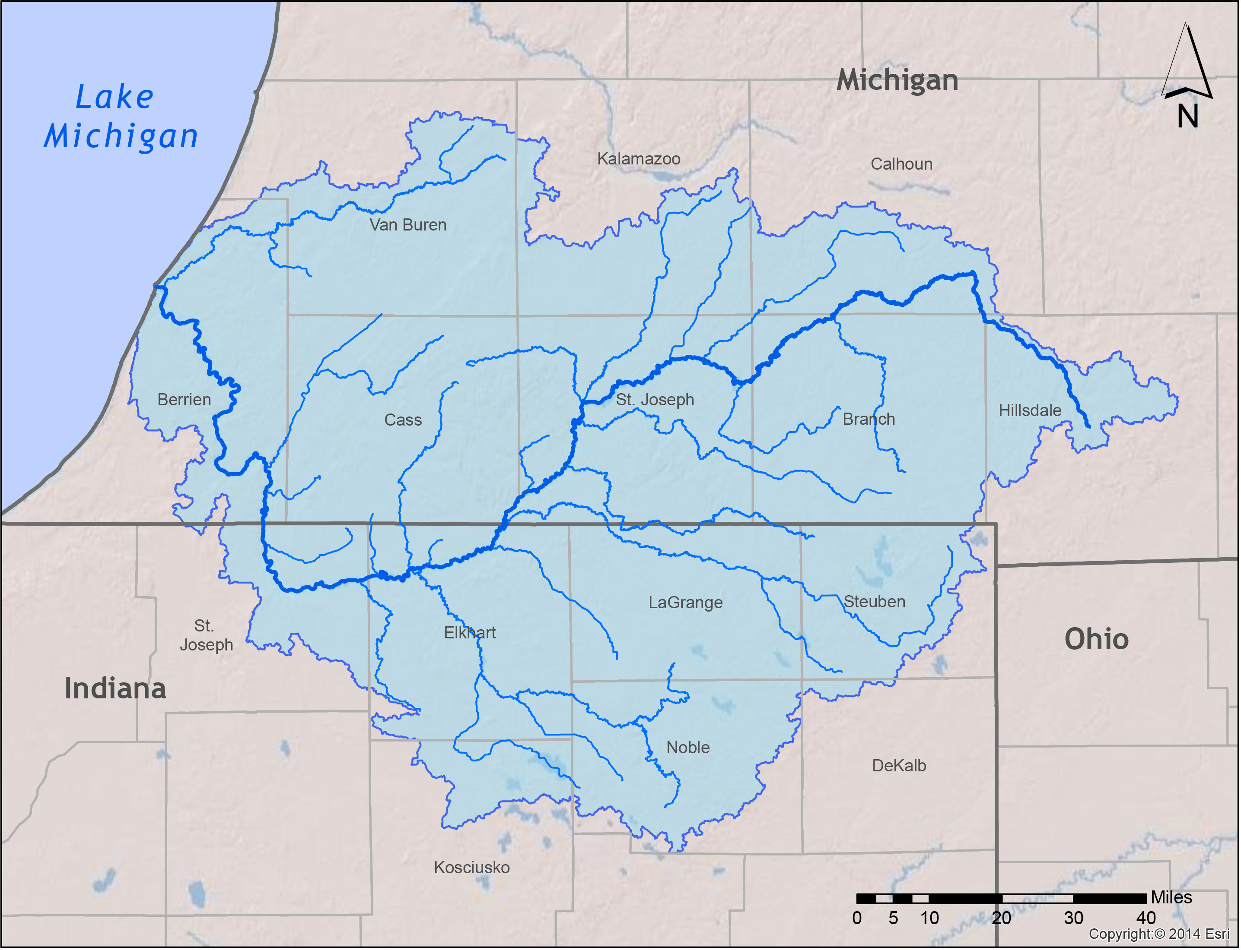
Our Watershed
The St. Joseph
River Basin
Notes:
Watershed Finder Online Tool: https://water.usgs.gov/wsc/watershed_finder.html
Our water boundary address
HUC 04 – Great Lakes Region
HUC 040500 – Southeastern Lake Michigan
HUC 0405001 – St Joseph
From there, the watershed breaks down into about 37 different small watersheds

Slide 7
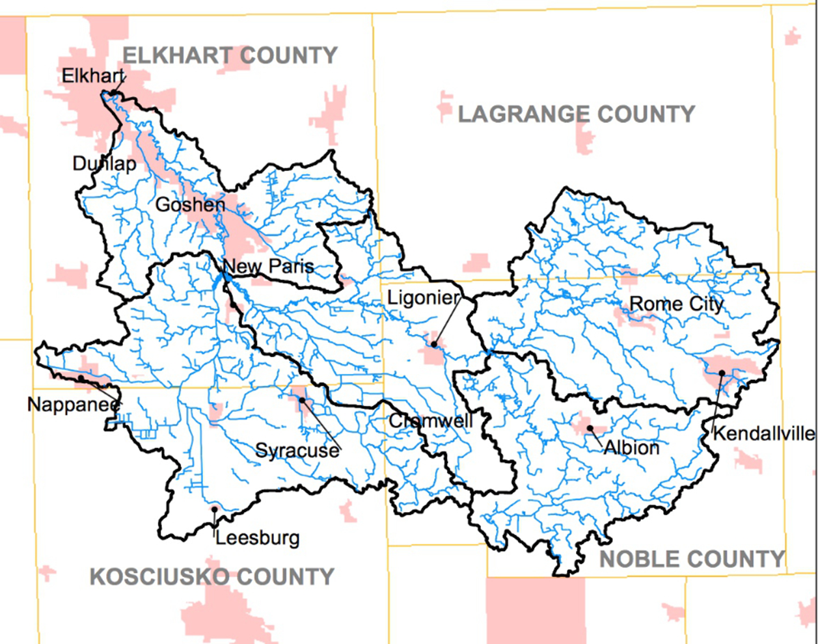
Our Watershed
Elkhart River Watershed

Slide 8
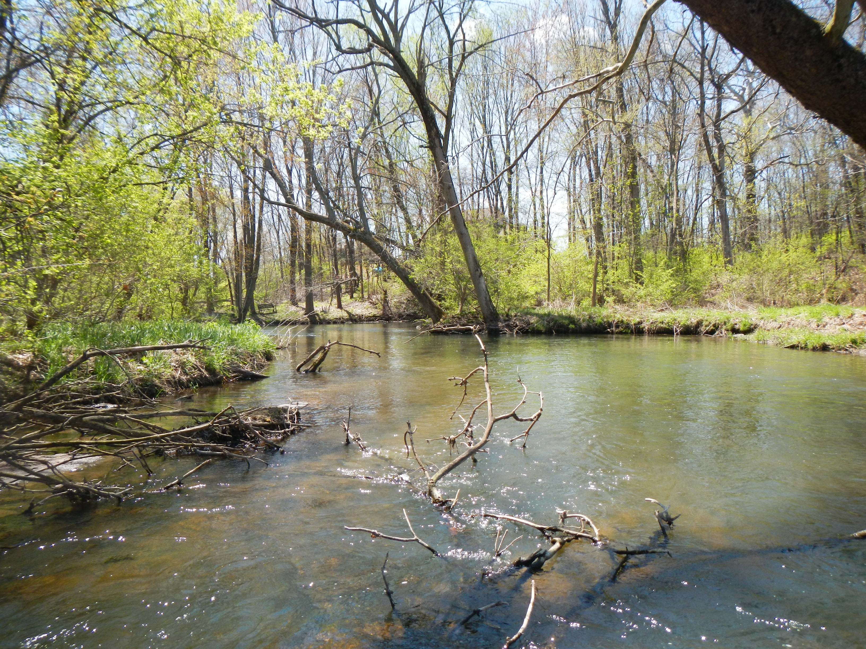
What is the source of our drinking water?
Notes:
Groundwater aquifers!
A whole report about our groundwater resources exists: https://www.in.gov/dnr/water/5757.htm
Summary on next page

Slide 9
Aquifers
The St. Joseph River Basin has both shallow and deep aquifers that are highly productive
A body of permeable rock that can contain or transmit groundwater
WHAT THAT REALLY MEANS IS:
In our area, groundwater is plentiful and we shouldn’t be running out any time soon.
Notes:
Because of Elkhart County’s history of glaciers, we have plentiful, unconsolidated, productive aquifers
Because of the annual rainfall amounts in our area (around 36”) and geographical location relatively close to the Great Lakes, we have no groundwater depletion
-----------------------
What’s unconsolidated mean?
Imagine a pocket or an area of sand underground (unconsolidated) versus a hard rock underground (consolidated)
They’re running out of groundwater out West, aren’t they?
More so than we are, yes. Out West, especially in the Ogallala aquifer system, they have very deep, consolidated aquifers. This not only makes the water hard to access but it also makes it hard for the aquifers to fill back up from rainfall infiltrating into the subsurface. For example, when we drill a well to get groundwater for a house, we have to usually drill no more than 80 feet. In the Ogallala, when they drill a well to get groundwater for their house, they have to drill no less than 120 feet.

Slide 10
Quantity vs Quality
Should Elkhart County’s conservation efforts focus on the QUANTITY of water or the QUALITY of water?
So, we have plenty of water…
Notes:
We are lucky to have a plentiful water resource, we need to take care of it!
The following slides will outline ways we can take care of our water resource.

Slide 11
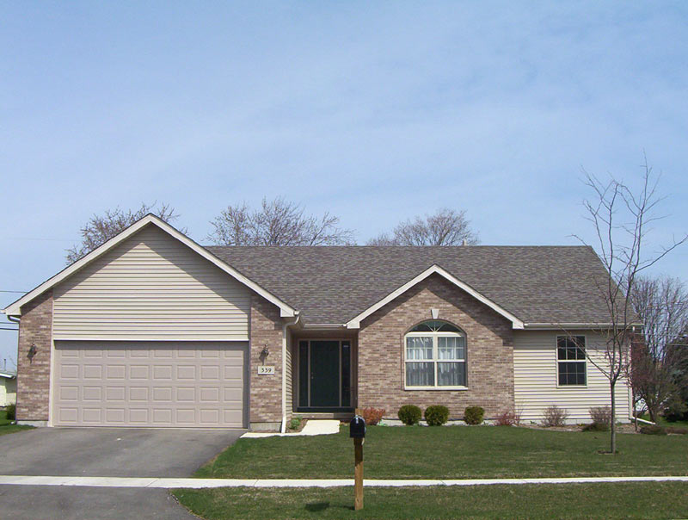
Protecting Water Quality
A 1,500 square foot house on a small lot produces 5,000 gallons
of runoff from a
1 inch rain storm
Put it context!
That amount of water would fill your bathtub
125 times!
This Photo by Unknown Author is licensed under CC BY-SA
Notes:
First, let’s think of how much water we are dealing with.
You can do these calculations based on any surface

Slide 12
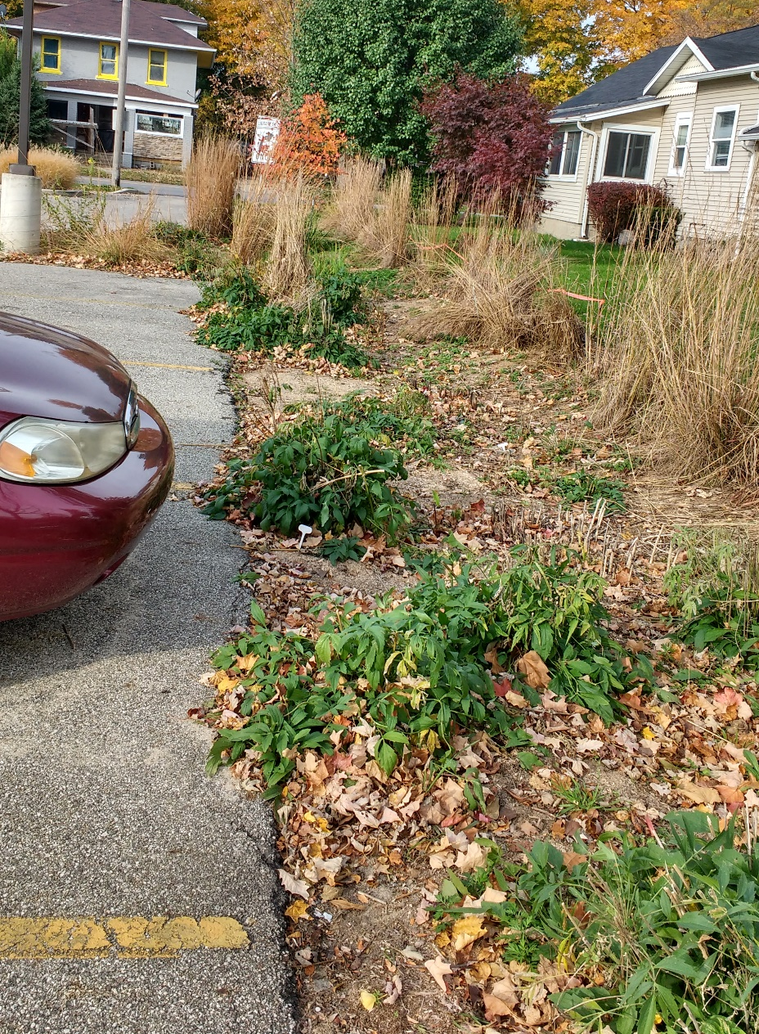
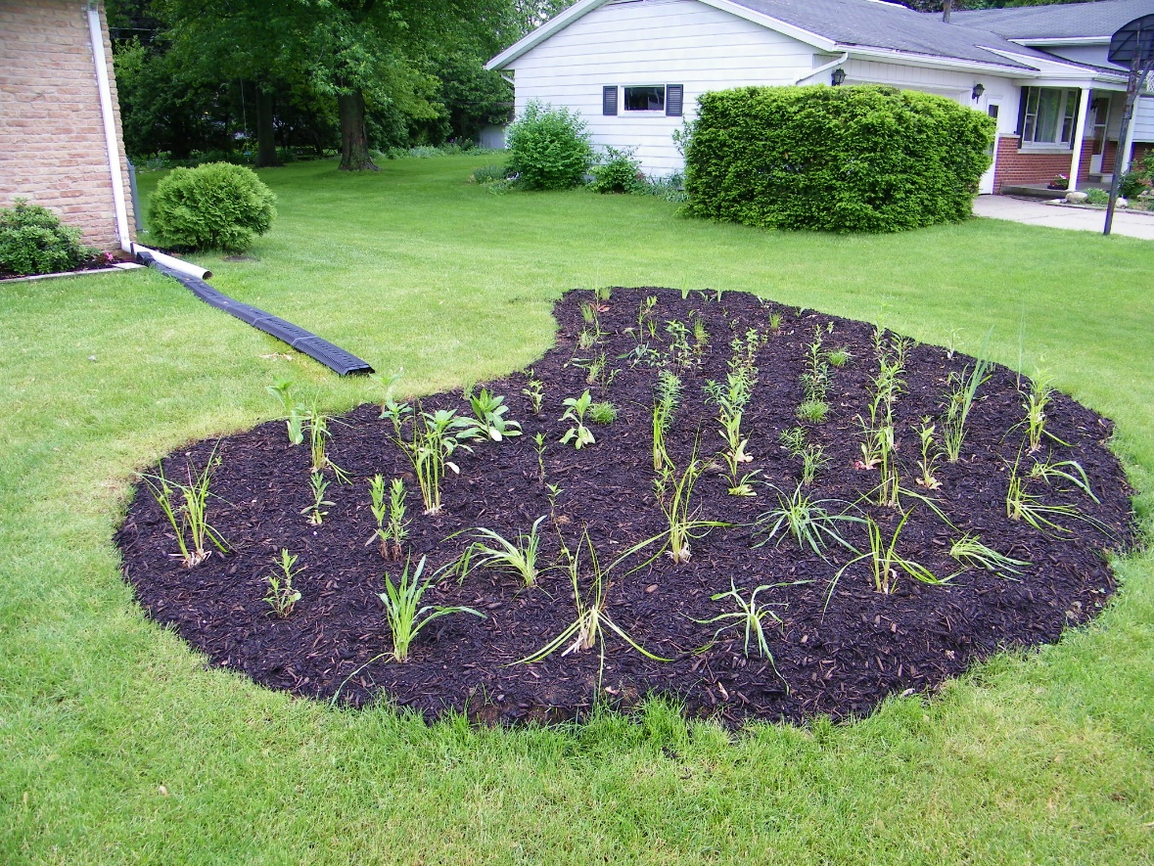
Protecting Water Quality
Rain Gardens
Notes:
Left picture: (Credit: Elkhart Co SWCD) Residential rain garden installed to slow down and filter water from the roof of a house
Right: (Photo Credit: Elkhart Co Indiana Master Naturalist) Rain garden at Goshen Library to help slow and filter runoff water from the parking lot
Rain gardens are specially constructed areas that use native plants to slow down and filter runoff water.
More information from the EPA on rain gardens: https://www.epa.gov/soakuptherain/soak-rain-rain-gardens
((((The Elkhart County Soil and Water Conservation District has a cost-share program for rain gardens. Get a hold of us to find out more!))))

Slide 13
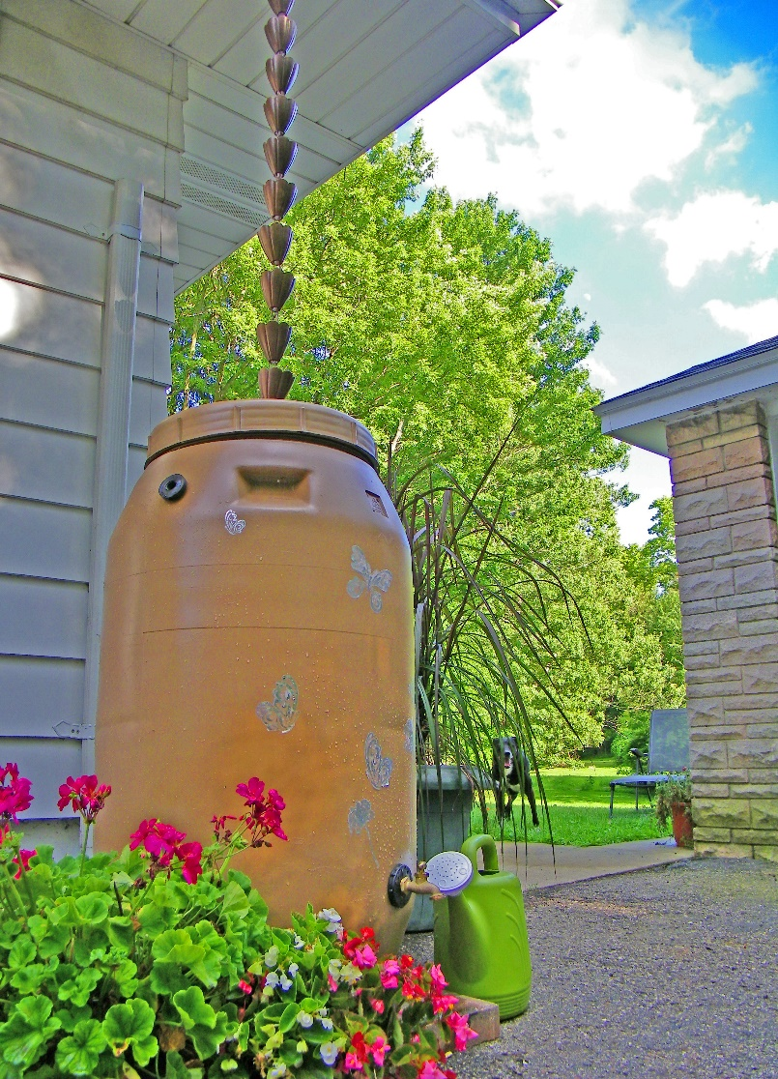
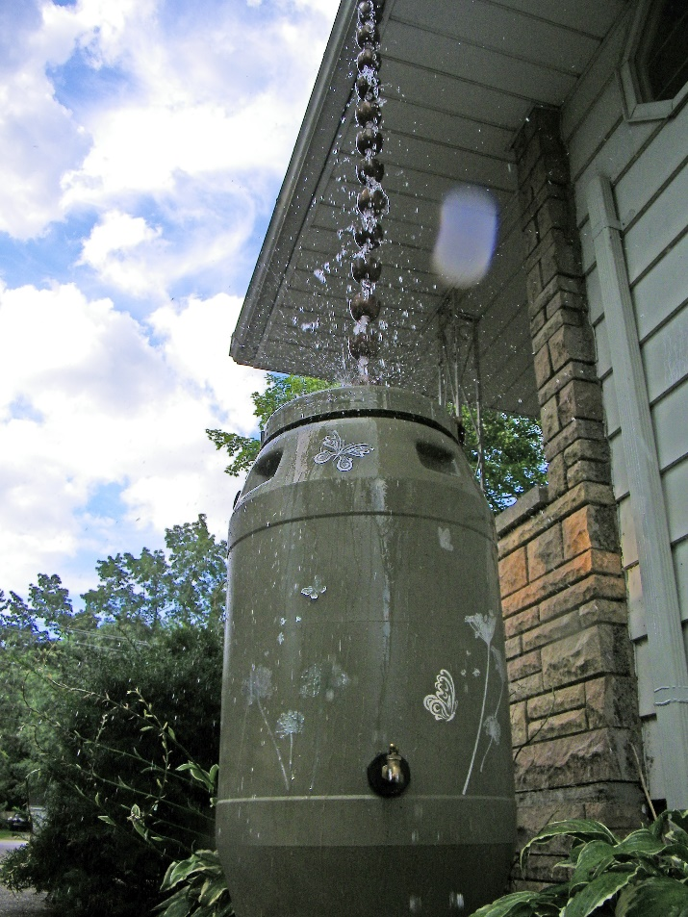
Protecting Water Quality
Rain Barrels
Notes:
Left: (Photo Credit: Elkhart Co SWCD) rain barrel with rain chain
Middle: (Photo Credit: Elkhart Co SWCD) installed rain barrel
Right : Goshen Library
More information on rain barrels: https://www.epa.gov/soakuptherain

Slide 14
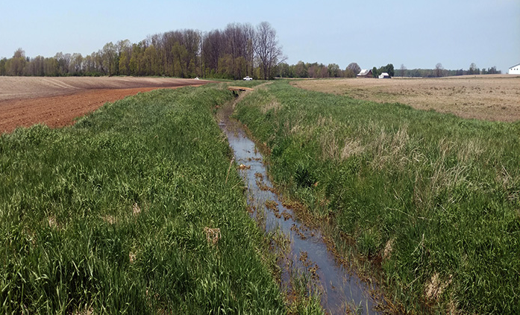
Protecting Water Quality
Filter Strip
(a.k.a. buffer strip)
Notes:
(Photo credit: Elkhart Co SWCD): grass filter strip along ditch
A filter strip is a buffer of intentionally planted grasses that act as a filter and a way for water to slow down before entering a drainage ditch or other waterway (creek, river, lake, etc)
In our area, grasses work better than trees or shrubs as a buffer strip because of our soil type and need of ditch/waterway maintenance.
Filter strips can be used in agricultural and urban landscapes. Although they tend to look a little different, they serve the same purpose.
More information on filter strips: https://www.nrcs.usda.gov/wps/portal/nrcs/detail/national/landuse/rangepasture/?cid=nrcs142p2_044352

Slide 15
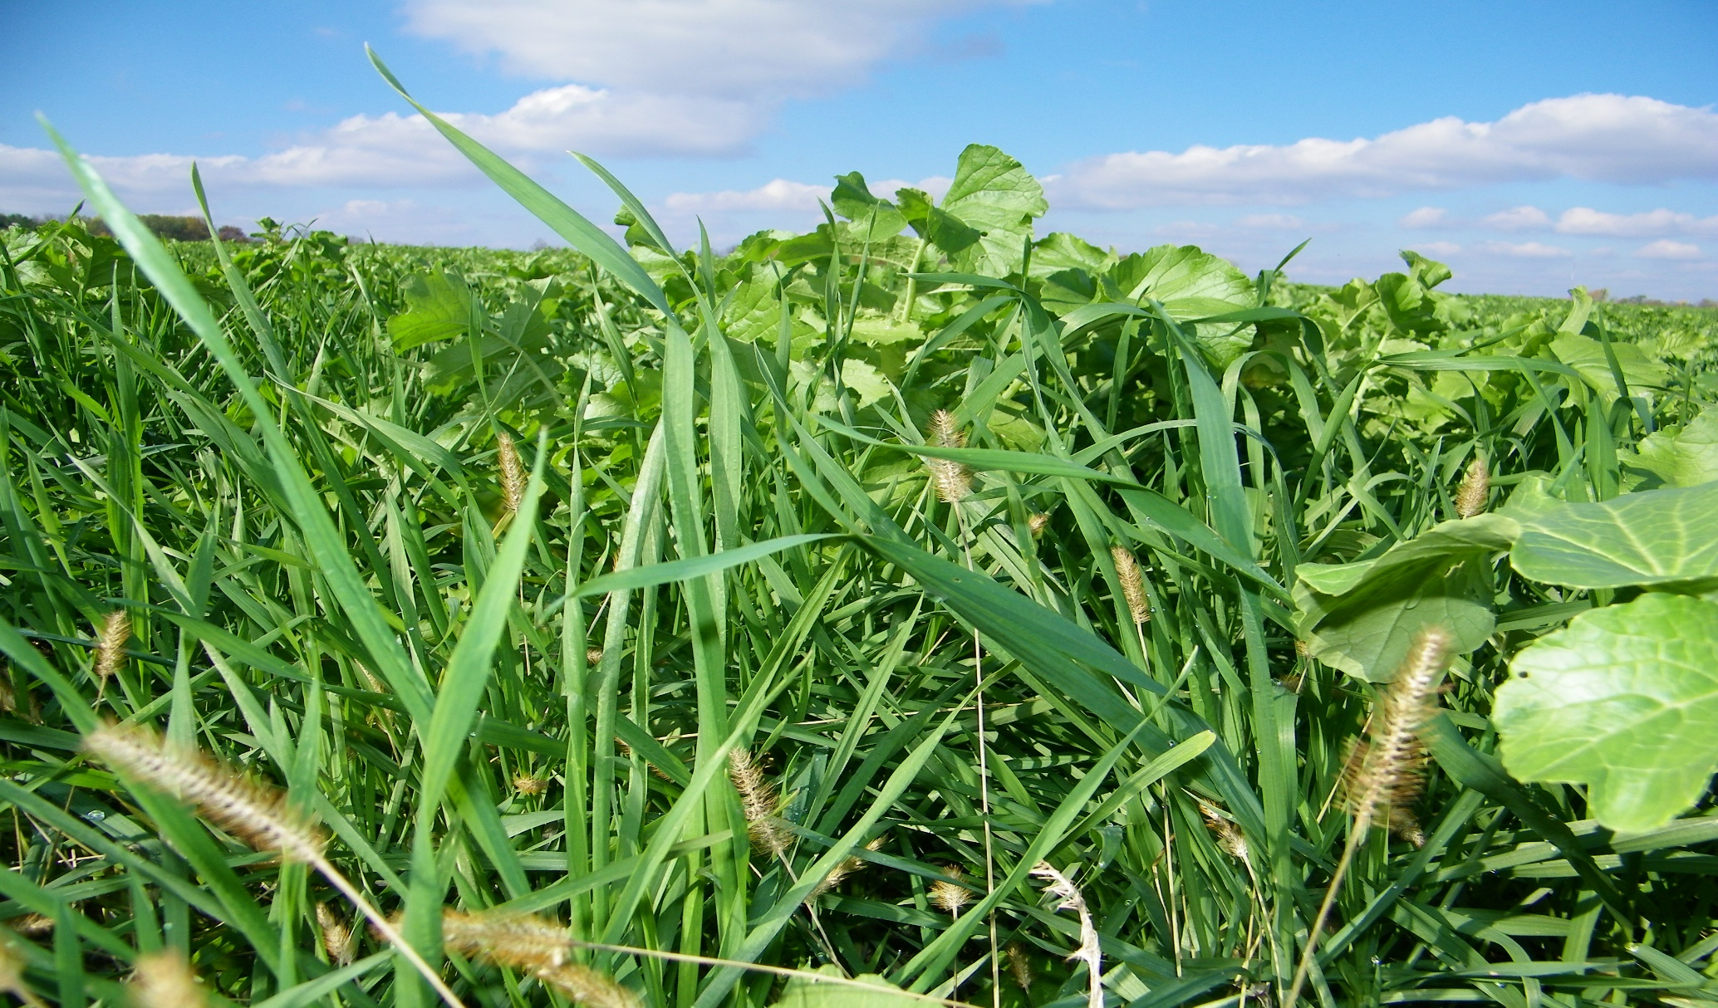
Protecting Water Quality
Cover Crops
Notes:
(Photo Credit: Elkhart Co SWCD): Cover crop mix in the fall after sweet corn harvest
Cover crops are plants grown on agricultural fields or in gardens during the winter, or the off-season. This is a time when the “cash crop” (corn, soybeans, or vegetables) are not growing.
Cover crops keep a living root in the soil, reduce soil erosion, reduce compaction, and help cycle nutrients. This not only leads to better soil health, but it leads to better water quality. This is because the cover crops stops runoff water from leaving agricultural land during the fall/spring storms and the winter freeze/thaw.
Farmers can plant one species of cover crop, or they can mix the seed to get a more diverse cover crop stand. Common cover crops in Elkhart County include: ryegrass, turnips, radishes, and oats.

Slide 16
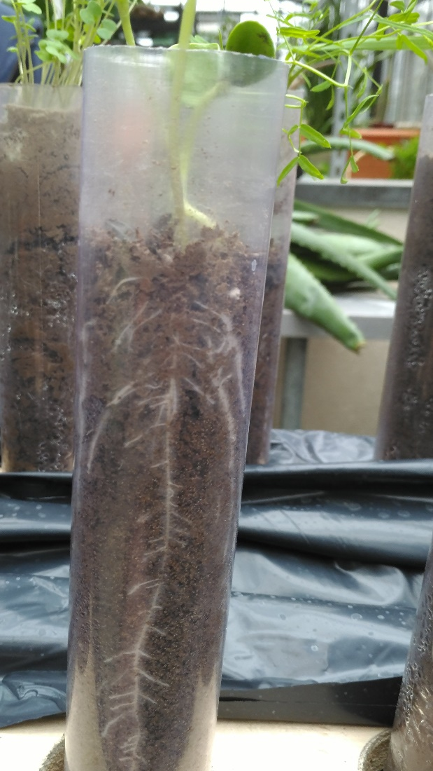
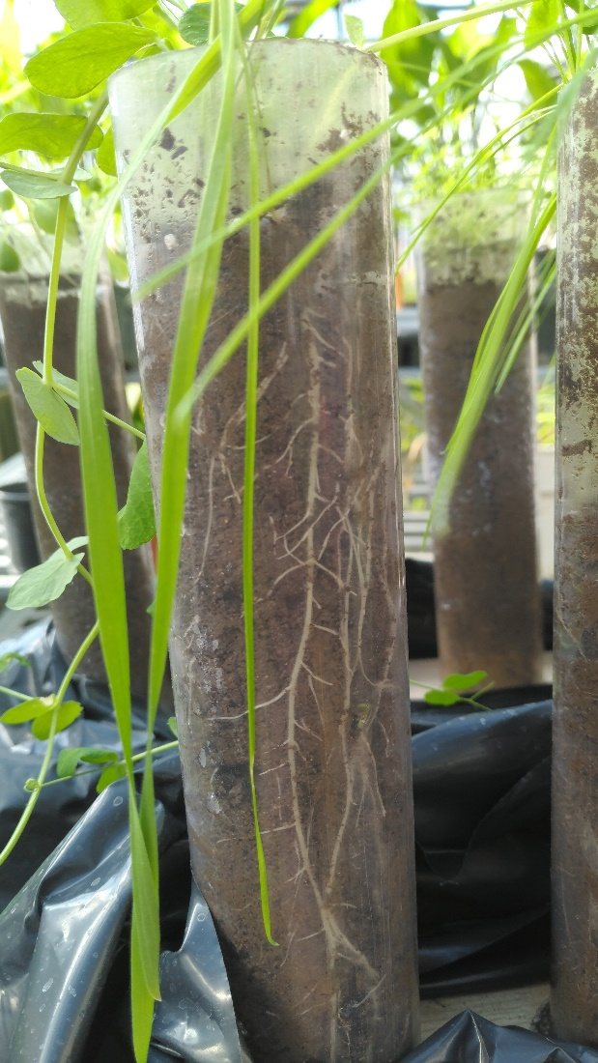
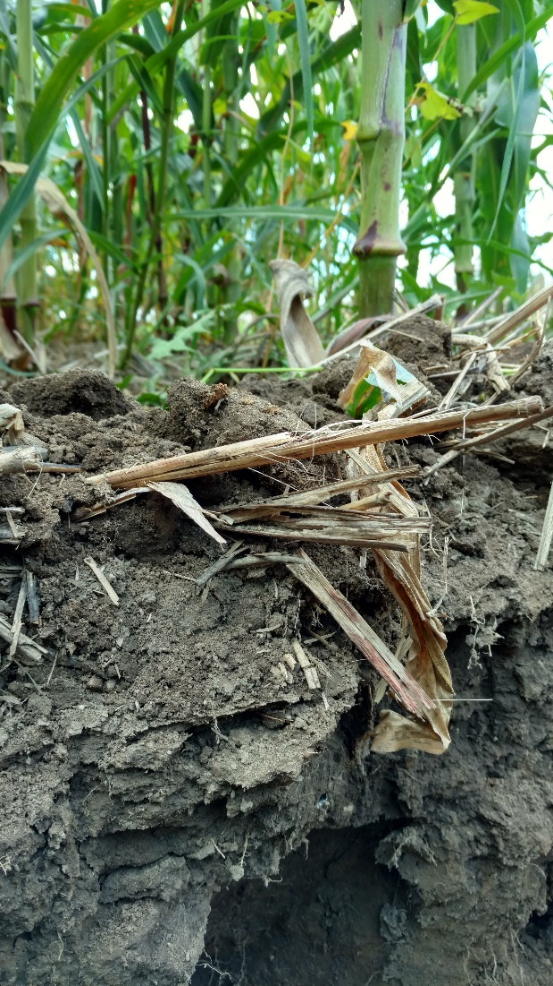
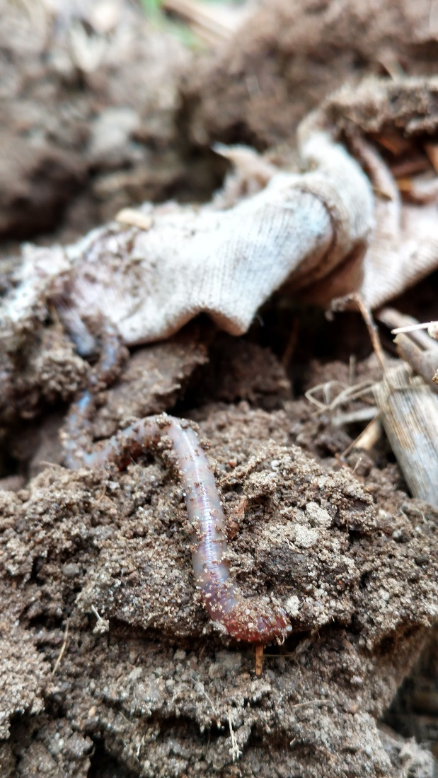
Infiltration and Runoff
Demonstration
Notes:
Infiltration (water going down into the soil) and runoff (water flowing across the surface of the soil) are important terms to know. Infiltration happens when the soil is healthy: when it has good structure, plant life, and “bug” life living in it. Runoff happens when we have bare soil that is compacted.
We want infiltration. We do not want runoff.
Runoff carries the pollutants that make our waterways dirty and unsafe. If we can slow down the water and infiltrate it into the soil, our water quality will improve.
Contact the Elkhart County SWCD for a demonstration on infiltration and runoff

Slide 17
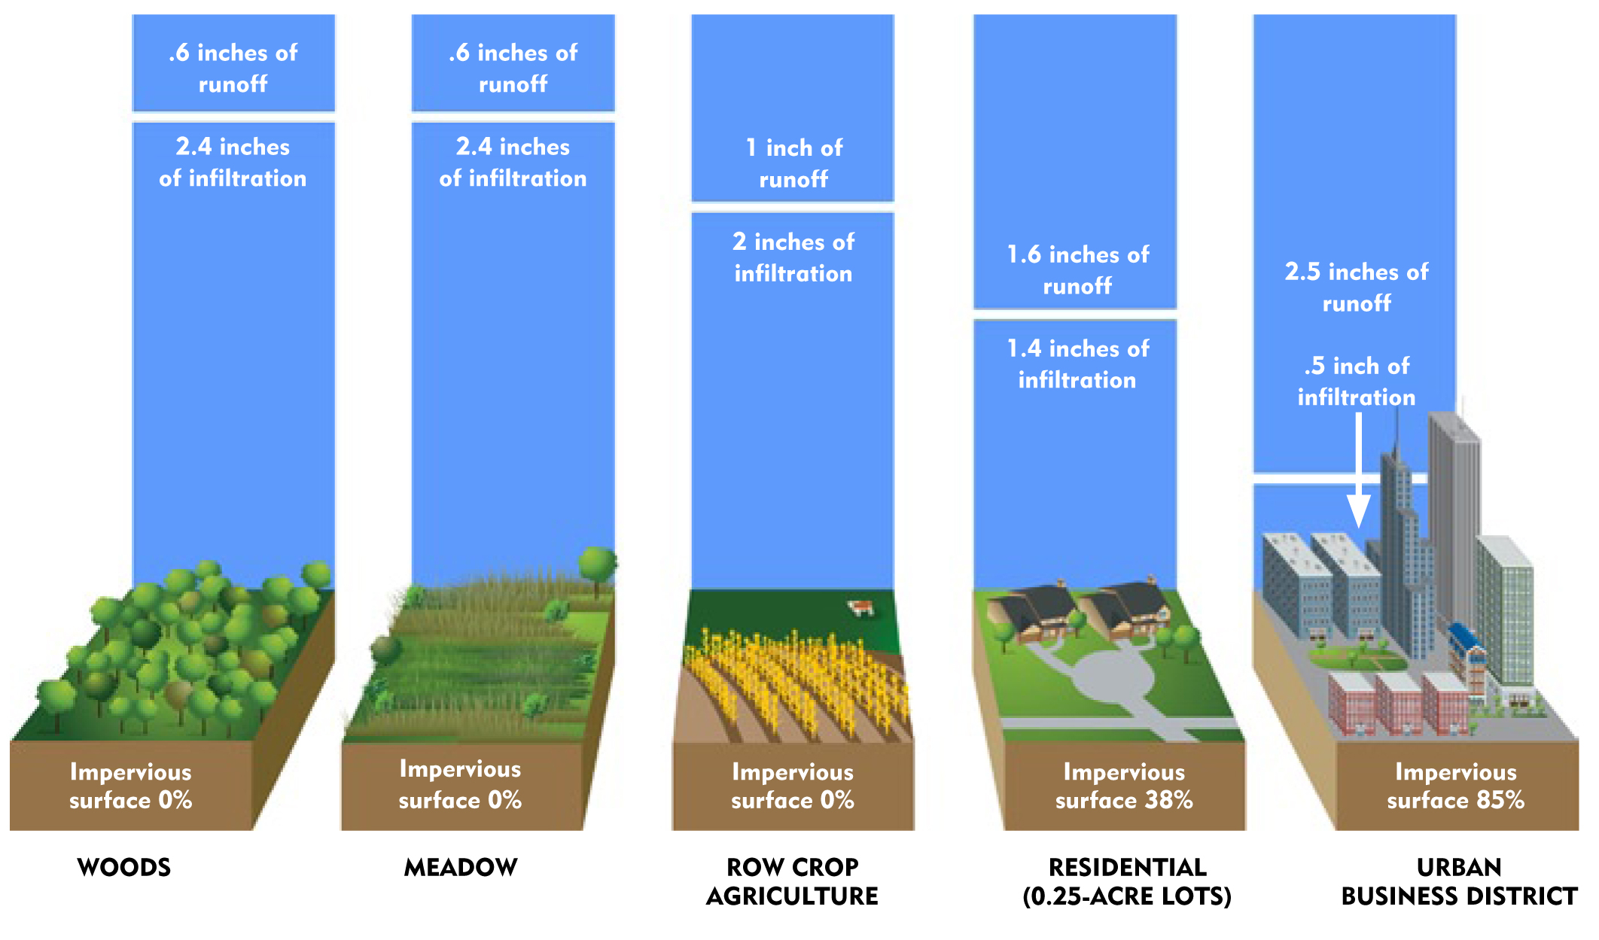
Infiltration and Runoff
Impervious
vs.
Pervious
Notes:
What areas of land will infiltrate and what areas of land will runoff?
This is just a general look of impervious vs. pervious surface.
Impervious surfaces speed the water up and cause runoff (bad things)
Pervious surfaces slow the water down and cause infiltration (good things)

Slide 18
Explore these links and the “notes” section below each slide for background information
Learn More!

Slide 19
Supporting Information, Resources, and Classroom Activities
National Geographic Lesson Plans:
https://www.nationalgeographic.org/education/resource-library/
NASA Water Education Lesson Plans:
https://pmm.nasa.gov/education/lesson-plans/water-conservation
PBS Water Conservation Lesson Plans:
https://indiana.pbslearningmedia.org/resource/ess05.sci.ess.watcyc.lp_waterconservation/water-conservation/

Slide 20
Still want to know more? Contact us!
Elkhart County Soil and Water Conservation District
17746-B County Road 34
Goshen, IN 46528
574-533-4383 ext 3
www.elkcoswcd.org
Notes:
Thank you, contact us any time!
We are available to come and do presentations as well as provide more background information and/or lesson planning support for educators in Elkhart County!

